Slide 1
SAAESD Spring Meeting Schedules
2022 – Mini-LG - TX | 2030 – Jt. ASRED - AR
2023 – MS | 2031 – GA
2024 – Jt. ASRED - KY | 2032 – Jt. ASRED – FL
2025 – TN | 2033 – VA
2026 – Jt. ASRED - PR | 2034 – Jt. ASRED - LA
2027 – VA | 2035 – SC
2028 – Jt. ASRED - OK | 2036 – Jt. ASRED – AL
2029 – NC | 2037 – TX

Slide 2
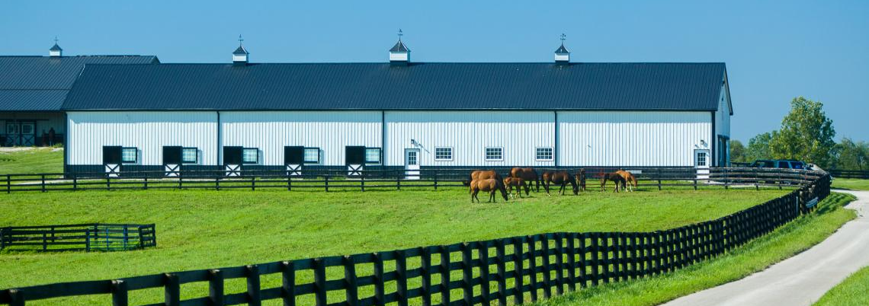
March 25-29, 2024
Lexington, KY
SAAESD/ASRED Spring Meeting
2024

Slide 3
Notes:
Reimagining the LGU-Industry Relationship

