Slide 1
SAAESD Spring Meeting
May 17, 2022
College Station, TX

Slide 2
ESCOP Priorities/Progress
Support increased appropriations for USDA-NIFA to enhance capacity funding for research, Extension and education and fully fund the AFRI competitive grants program.
BLC recommendation for a 14% increase in appropriations for Hatch and AFRI over FY 2021 enacted funding was approved through the APLU process.

Slide 3
ESCOP Priorities/Progress
Develop new funding opportunities to address critical infrastructure for Colleges of Agriculture at Land-Grant Universities
Acting on Gordian report of infrastructure needs/deferred maintenance ($11.5 B) for Colleges of Agriculture APLU/BAA proposed funding through the Research Facilities Act.
BAC and Policy Board of Directors recommended $365 M for FY 23 NIFA budget for 1862 and other land grant universities infrastructure funding.
ESS will be reconstituting the ARIA committee to renew efforts to garner support for infrastructure funding.

Slide 4
ESCOP Priorities/Progress
Strengthen strategic partnerships with traditional and nontraditional entities
Developing stronger relations with NIFA through interactions with their leadership. Will initiate interactions with the new leadership (Dionne Toombs).

Slide 5
ESCOP Priorities/Progress
Fully Integrate Diversity, Equity and Inclusion as an essential component of all our programs.
Call to action by Diversity Catalyst Committee to recognize how racial injustices may have occurred in the past and to ensure that these programs/practices do not perpetuate these injustices.
Improve the organization readiness and strategic capacity to deal with the next major crisis. Ongoing

Slide 6
ESCOP Priorities/ Progress
Adopt and implement a strategic plan for communications and marketing, including transitioning the National Impact Database Committee to a subcommittee of APLU’s CMC.
Transition was approved by ESS leadership and is now pending a vote for approval.

Slide 7
ESCOP Priorities/Progress
Implement national and regional research among universities/institutions to help control the COVID-19 pandemic, support economic development, tackle climate change and advance racial equity as well as retain America’s position as the world leader in agricultural research.
Science and Technology Committee asked all regional associations to crosswalk their multistate committee portfolios with both NIFA priorities related to the Administration’s goals and the Grand Challenges from the ESCOP roadmap.

Slide 8
Chairs Initiatives
Strengthen partnership and engagement with NIFA, including Project CAFÉ, the NIFA reporting system, Land Grant University to You (LGU2U) comprehensive map of all branch experiment station sites and other items that may arise.
Northcentral Region continued work with NIFA on LGU2U efforts with sessions on Accountability and Compliance and Sustaining the Partnership since the beginning of my term.
Updating a 2015 interactive map of the branch stations for the 1862 Land-grant experiment stations.

Slide 9
Chair Initiatives/Progress
Develop and implement strategies to equitably distribute potential funding for critical infrastructure for Colleges of Agriculture at Land-grant Universities.
The ESS previously funded the Gordian Study (refresh of the 2015 Sightlines study on deferred maintenance and replacement costs for colleges of agriculture facilities across the nation).
Continue to monitor congressional action regarding funding of the Build Back Better bill.

Slide 10
Chair Initiatives/Progress
Develop and implement a strategy to make increased capacity funding a priority for 1862, 1890 and 1994 land grant colleges and universities.
I sent letter to NIFA requesting an initial increase of 28% for FY 23, with subsequent 14% increases for at least the next 5 years. A 28% increase for FY 23 would have raised Hatch Funds to $329 Million which was consistent with the President’s FY 22 proposed budget. Subsequent 14% increases would keep pace with China’s budget increases for Agriculture.
I also support the efforts of the 1994 Land-grants to increase each of their capacity lines to a total of $17.5 M.

Slide 11
Chairs Initiative/Progress
Position ESS and its LGU members to take a leading role in addressing climate change challenges as they impact agriculture and natural resources.
Climate change challenge session was held at ESS meeting in Lake Tahoe in October.
Forming an ad hoc committee to advise ESCOP leadership on Climate Change issues as strategized at Tahoe Meeting.
  Organize interdisciplinary teams to support specific climate change programs
  Engage internal and external agencies to address specific climate change issues.

Slide 12
Chairs Initiative/Progress
Develop an ESS Brand and Advocacy Toolkit to provide ESCOP leadership and ESS members with consistent messaging and resources focused on ESS advocacy and educational priorities.
Solicited proposals and interviewed marketing firms to help with a brand refresh and development of an advocacy toolkit.
Selected a firm “PIVOT” to assist ESS with our brand refresh.
Formed an ad hoc committee to help develop the ESS brand and toolkit with representation from all regions. First meeting was held on May 10th.

Slide 13
Major Challenges Facing ESS
Development of a highly recognizable brand that our stakeholders and the public will immediately associate with the Experiment Stations of the Land-grant University System.
Improving our relationship with the APLU system and developing and implementing a strategy so that our priorities (i.e. capacity funding) are better represented by APLU.

Slide 14
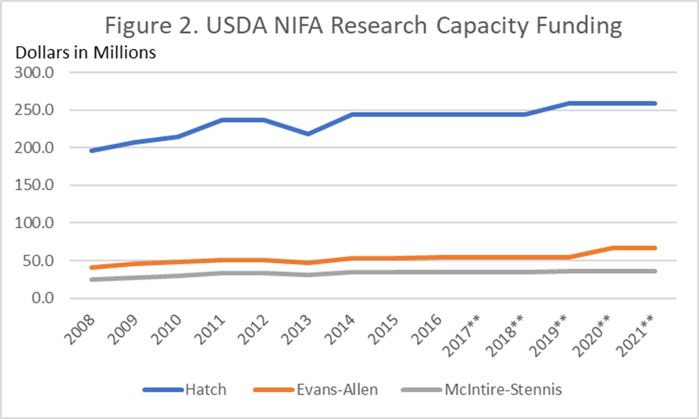
Capacity Funding

Slide 15
ESCOP Budget Recommendation Process
October 21 CAC Meeting – Process established in KC meeting discussed and BLC charged with developing budgets for AFRI and Hatch consistent with the BAC Advocacy Principles. Asked to report back to ESCOP for approval.
Due to time constraints BLC forwarded budget to BAC on 11/7/21 prior to ESCOP formal approval.
ESCOP Executive Committee approved the BLC recommendation at its 11/12/2021 meeting

Slide 16
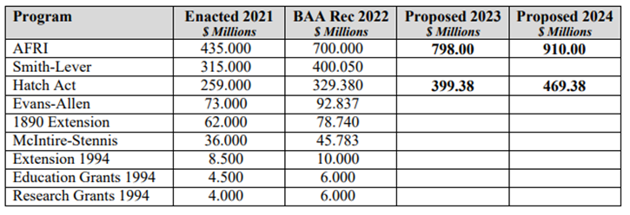
BLC Proposed Request Submitted to BAA/BAC on 11/7/2021 and then Approved by the
ESCOP Executive Committee on November 12, 2021

Slide 17
Unified Ask Comparisons FY 22 vs FY 23
Program | FY 2022 Unified Ask | FY 2021 Enacted | ESS Approved FY 2023 Ask | BAC FY 2023 Proposed Level of Funding | Percent Change From FY 2022 Unified Ask
 | $ Millions
AFRI | 700.0 | 435.0 | 798.0 | 496.0 | 29% Decrease
Hatch | 329.4 | 259.0 | 399.38 | 295.0 | 10.5% Decrease
Smith-Lever | 400.1 | 315.0 |  | 428.2 | 7.1 % Increase

Slide 18
Thanks

Slide 20
Unbalanced Representation on
Budget Recommending Committees
Budget and Advocacy Committee (BAC) – 15 voting members recommend budgets for NIFA funding to Policy Board of Directors - 1 of 15 voting members selected by ESS, 1 by ARD
Policy Board of Directors (PBD) – 10 voting members – Vote to approve BAC recommendation – 1 of 10 voting members selected by ESS, 1 by ARD
Research Assessment Fees - Research assessment based upon NIFA funding over average of 3-year period at a rate of 60% for capacity and 40% for competitive funding. Why are capacity funds assessed at a higher rate.

Slide 21
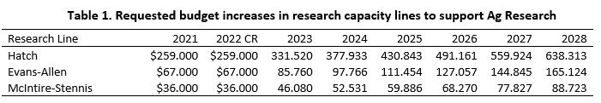
Budget Request in Chairs Letter to NIFA Director
Proposed 28% increase for FY 23 and subsequent 14% increases for next 5 years to keep up with China investment rate of 14%/year.
$331.52 Million is consistent with President’s proposed FY 22 budget for Hatch of $329

Slide 22
BAC/BAA Priority Comparison Table
Program | Enacted FY 2021 | House Bill FY22 | Senate Bill FY22 | Option 1* | Option 2 | Option 3 | BAC FY 2023 Proposed Level/% over FY 2021
 |  | $ Millions | $ Millions | $ Millions | $ Millions | $ Millions | $ Millions
AFRI | 435.0 | 450.0 | 445.0 | 700.0 | 700.0 | 700.0 | 496M (14%)
Hatch Act | 259.0 | 265.0 | 275.0 | 329.4 | 352.6 | 399.0 | 295 (14%)
Evans-Allen | 73.0 | 92.8 | 73.0 | 92.8 | 99.4 | 118.1 | 99.4 (36%)
McIntire-Stennis | 36.0 | 38.0 | 40.0 | 45.8 | 49.0 | 46.0 | 46 (28%)
Research Grants 1994 | 4 | 4.5 | 5.0 | 6.0 | 6.4 | 17.5 | 17.5 (337.5%)
Research Total | $807 | $850.3 | $838.0 | $1,174 | $1,207 | $1,281 | $953.9 (18.2%)
Smith-Lever | 315.0 | 320.0 | 330.0 | 400.1 | 428.2 | 455.8 | 428.2 (36%)
1890 Extension | 62.0 | 67.0 | 62.0 | 78.7 | 84.3 | 100.2 | 84.3 (36%)
Extension 1994 | 8.5 | 9.5 | 10.0 | 10.0 | 10.7 | 17.5 | 17.5 (105.9%)
Extension Total | $385.5 | $396.5 | $402.0 | $488.8 | $523.2 | $573.5 | $530 (37.5%)
Education Grants 1994 | 4 | 5.5 | 6.0 | 6.0 | 6.4 | 17.5 | 17.5 (288.9%)
Women & Minorities in STEM | 0.4 | 1 | 2 |  |  | 10 | 10
Education Total | $4.4 | $6.5 | $8 |  |  | $27.5 | $27.5 (525%)
*Option 1 – FY2022 Unified Ask; Option 2 – FY2022 Unified Ask +7% (inflation); Option 3 – Individual Section/Group Ask

Slide 23
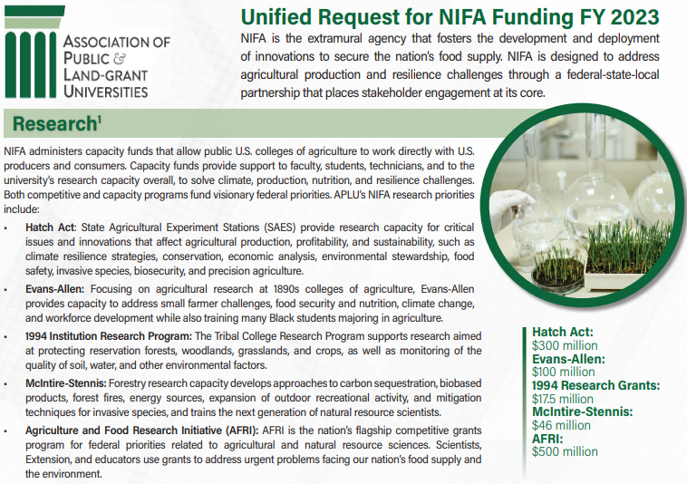
Research Unified Request Approved by PBD

Slide 24

FY23 Infrastructure Request Approved by PBD

Slide 25

Infrastructure Request Approved by PBD

Slide 27
Background
Ph.D. – Biochemistry – Univ. of Nevada, Reno – Oxidative Stress
Post-doc – Biochem/Pharmacol. Yale University
University of Nevada, Reno – Dept. of Nutrition – Dept. of Agriculture, Nutrition and Veterinary Sciences
  Chair – 2000 – 2015
  Director NAES – 2015 – Present
WAAESD – Executive Committee 2016 – Present
  Chair 2018 and 2019
ESCOP Chair Elect – 2020; Chair 2021

