Slide 1
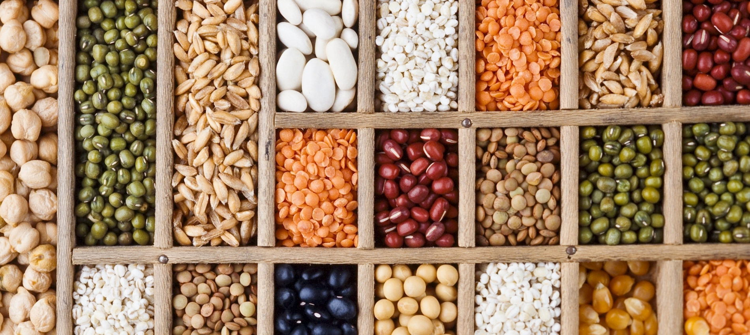
S9 Multi-State Committee:
Plant Genetic Resources, Conservation and Utilization (PGRCU)

Slide 2
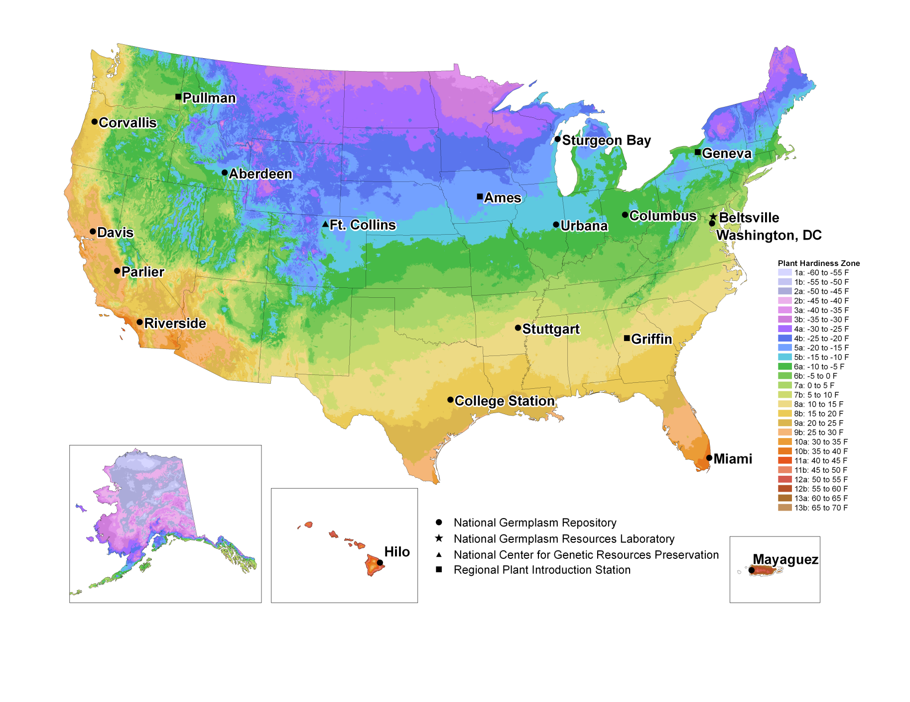
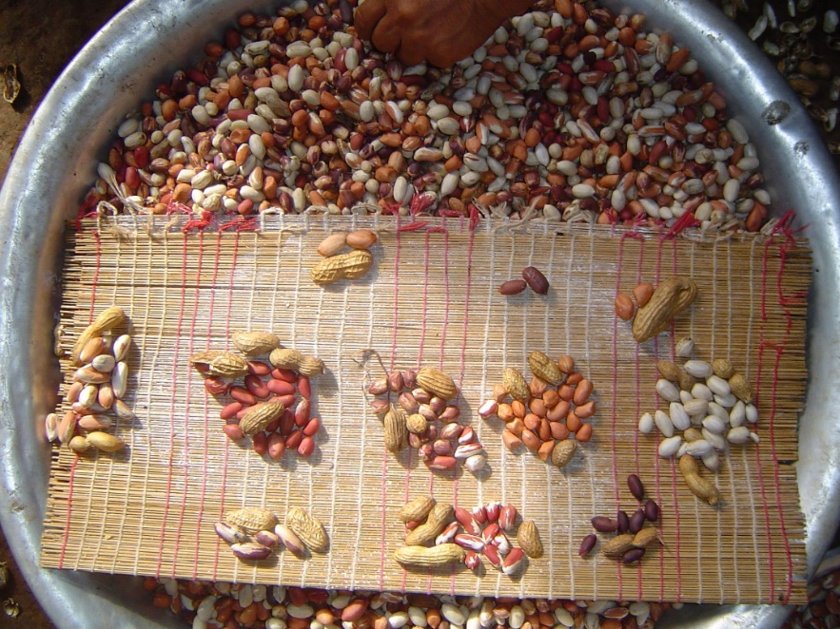
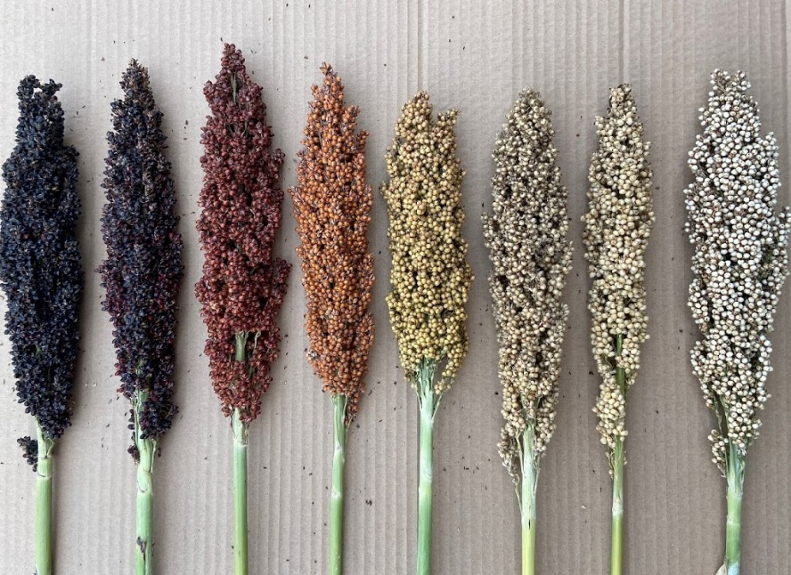
USDA National Plant Germplasm System (NPGS)

Slide 3
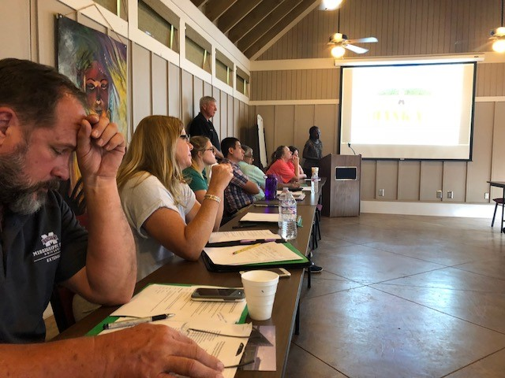
STATE |  | REPRESENTATIVE
AL |  | Charles Chen
AR |  | James Correll
FL |  | Kevin Kenworthy
GA |  | Soraya Bertioli
GU |  | Mari Marutani
HI |  | Vacant
KY |  | Timothy Phillips
LA |  | Don LaBonte
MS |  | Brian Baldwin
NC |  | Carlos Iglesias
OK |  | Yanqi Wu
PR |  | Carlos Flores Ortega
SC |  | Richard Boyles
TN |  | Virginia Sykes
TX |  | Gerald Smith
VI |  | Thomas Zimmerman
VA |  | Bastiaan Bargmann
 |  | ADDITIONAL
STATE |  | PARTICIPANTS
MS |  | Jesse Morrison
PR |  | Diego M. Viteri-Dillon
SC |  | Sachin Rustgi
SC |  | Stephen Kresovich
TX |  | Jeff Brady
TX |  | Shuyu Liu
TX |  | John Cason

Slide 4
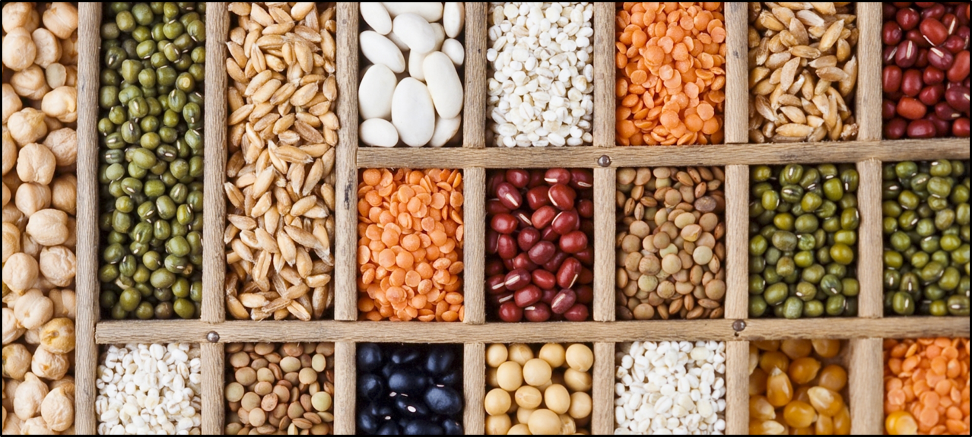

Slide 5
102,245 accessions 1600 species 286 genera

Slide 6
15,773 accessions to 1071 users

Slide 7
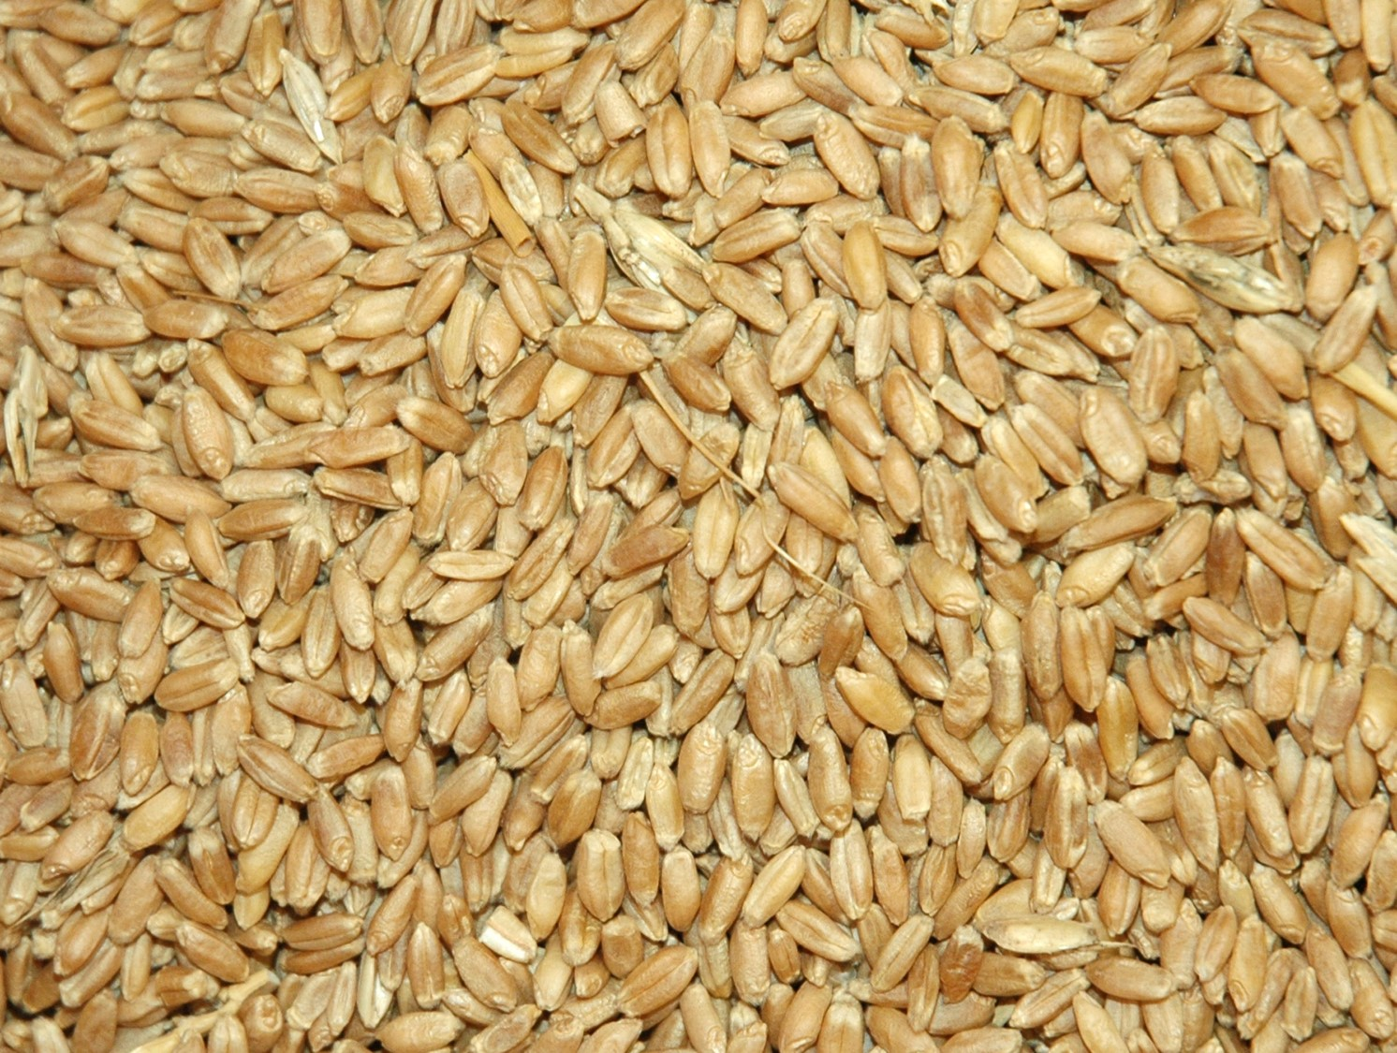


Slide 8

 | USDA/ARS Budget
 |  |  | FY2021 |  | FY2022* |  | FY2023**
 | Personnel |  | 1,534,447 |  | 1,691,000 |  | 1,742,100
 | Travel |  | 0 |  | 27,500 |  | 27,500
 | Indirect Costs |  | 430,203 |  | 451,854 |  | 471,140
 | Supplies |  | 369,226 |  | 223,451 |  | 153,165
 | Equipment |  | 5,771 |  | 10,100 |  | 10,000
 | Facilities Support |  | 95,000 |  | 95,000 |  | 95,000
 | Total Base Funds |  | 2,434,647 |  | 2,498,905 |  | 2,498,905
 | Area Office/HQ Funds |  | 70,500 |  | TBD |  | TBD
 | TOTAL FUNDING |  | 2,664,054 |  | 2,498,905 |  | 2,498,905
*Budget is based on additional base funding the unit anticipates receiving this fiscal year
to cover 3.85 salary increase that became effective January 2022.
**Personnel expense is based on proposed 4.6% salary increase for CY2023.
The total base funds for FY2023 may be increased to cover the increase in salary.

Slide 9
Option 2: Rehire the vacant Admin Support position PT (7.5 FTE).
 | S-009 Budget |  |  |  |  |  | Requested
 |  |  | FY2021 |  | FY2022 |  | FY2023
 | Personnel |  | 431,047 |  | 432,196 |  | 493,525
 | Travel |  | 1,000 |  | 1,000 |  | 1,000
 | Operations |  | 78,374 |  | 78,374 |  | 78,374
 | TOTAL |  | 510,241 |  | 511,570 |  | 572,899
 | Resulting deficit is 61,329. Equals 4,090 per LGU
Option 3: Abolish the vacant Admin Support position (7 FTE).
 | S-009 Budget |  |  |  |  |  | Requested
 |  |  | FY2021 |  | FY2022 |  | FY2023
 | Personnel |  | 431,047 |  | 432,196 |  | 465,945
 | Travel |  | 1,000 |  | 1,000 |  | 1,000
 | Operations |  | 78,374 |  | 78,374 |  | 78,374
 | TOTAL |  | 510,241 |  | 511,570 |  | 545,319
 | Resulting deficit is 33,749. Equals 2,250 per LGU
 | USDA/ARS Budget
 |  |  | FY2021 |  | FY2022* |  | FY2023**
 | Personnel |  | 1,534,447 |  | 1,691,000 |  | 1,742,100
 | Travel |  | 0 |  | 27,500 |  | 27,500
 | Indirect Costs |  | 430,203 |  | 451,854 |  | 471,140
 | Supplies |  | 369,226 |  | 223,451 |  | 153,165
 | Equipment |  | 5,771 |  | 10,100 |  | 10,000
 | Facilities Support |  | 95,000 |  | 95,000 |  | 95,000
 | Total Base Funds |  | 2,434,647 |  | 2,498,905 |  | 2,498,905
 | Area Office/HQ Funds |  | 70,500 |  | TBD |  | TBD
 | TOTAL FUNDING |  | 2,664,054 |  | 2,498,905 |  | 2,498,905
*Budget is based on additional base funding the unit anticipates receiving this fiscal year
to cover 3.85 salary increase that became effective January 2022.
**Personnel expense is based on proposed 4.6% salary increase for CY2023.
The total base funds for FY2023 may be increased to cover the increase in salary.

Slide 10
