Slide 1
Southern Rural Development Center
Liaison Report
John J. Green, SRDC Director and Professor
SAAESD Spring Meeting
at the Mini Land-Grant Conference
College Station, Texas
May 2022

Slide 2

Overview
Regional Rural Development Centers
Current Priorities and Plan of Work
  Developing Pathways to Resilient Communities
  Building Strategic Partnerships
  Mobilizing Resources around Emerging Issues and Opportunities
Items for Further Consideration
  Using Findings from the Listening Survey and Virtual Sessions
  Next-Steps with Heirs Property – Apply to Form a Southern Extension/Research Activity (SERA)

Slide 3
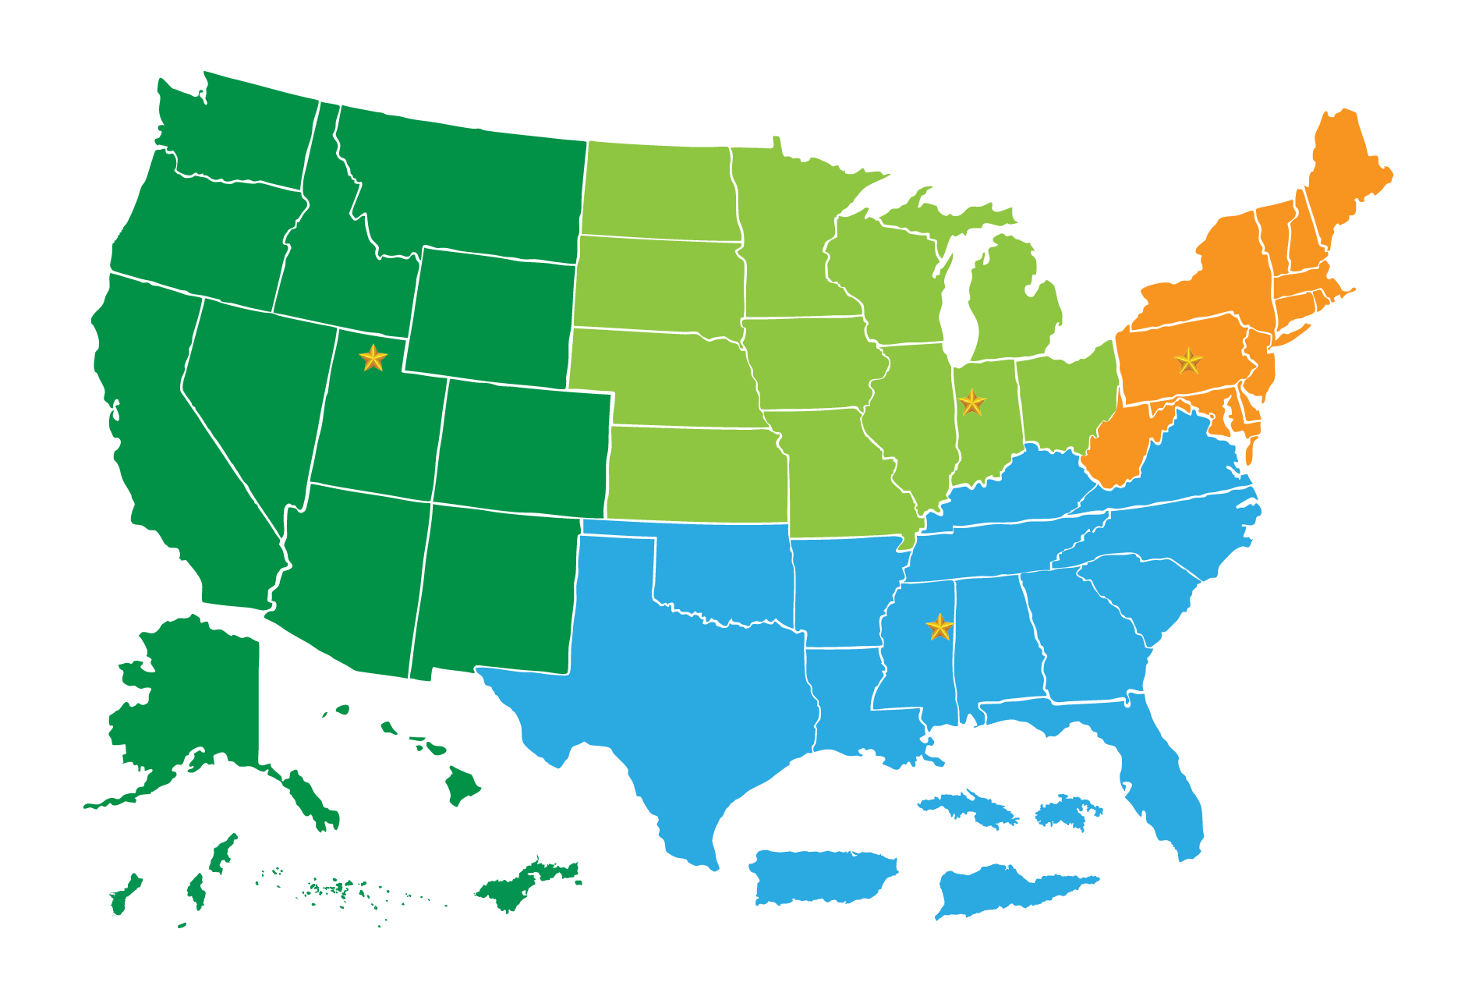

Regional Rural
Development Centers
North Central Regional Center for Rural Development (NCRCRD)
Northeast Regional Center for Rural Development (NERCRD)
Southern Rural Development Center (SRDC)
Western Rural Development Center (WRDC)
Established through the Rural Development Act of 1972, the Regional Rural Development Centers build capacity in the Land-Grant University System to address crucial needs in our nation's rural communities

Slide 4
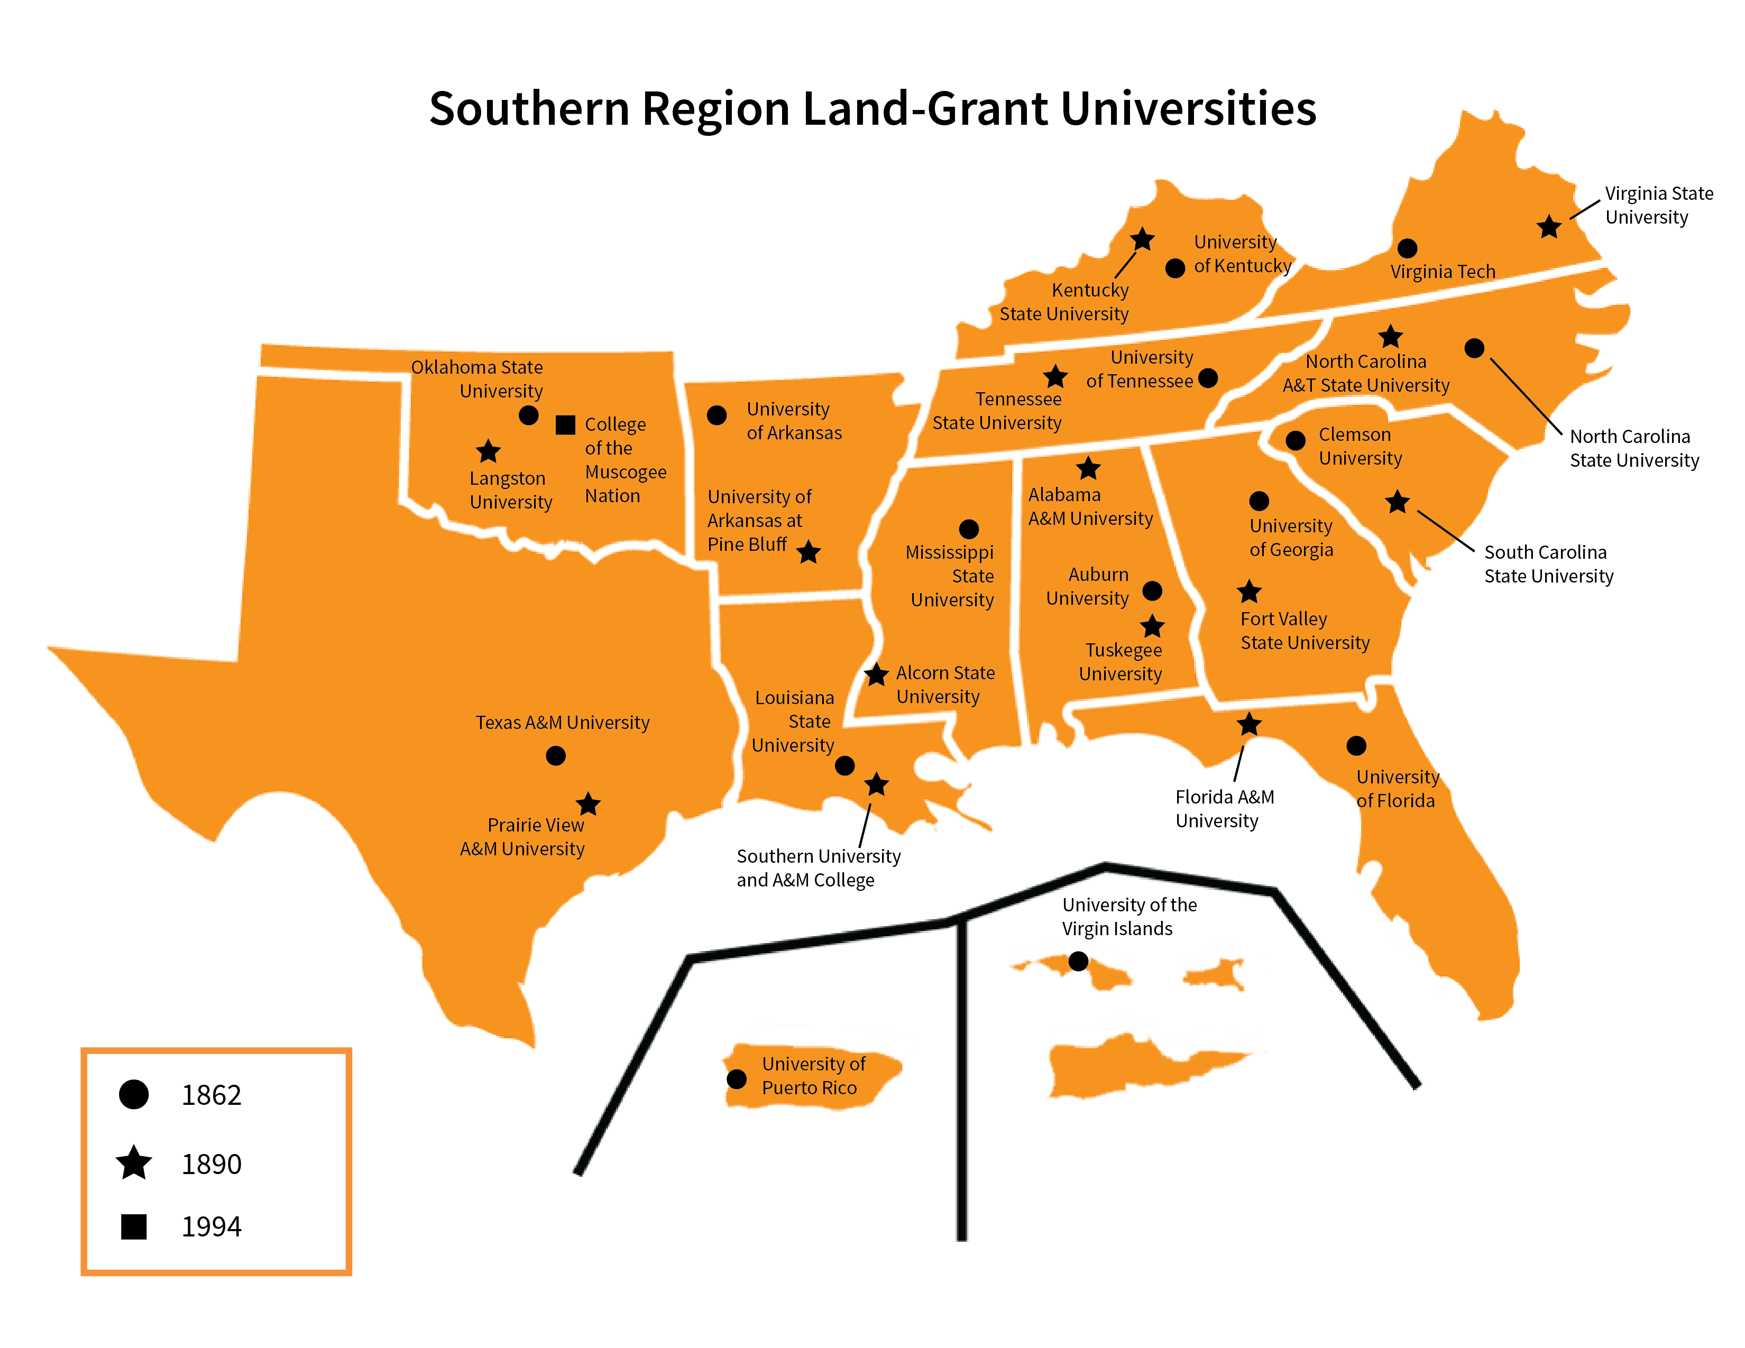
SRDC’s Mission
The Southern Rural Development Center seeks to strengthen the capacity of the region's 30 land-grant institutions to address critical contemporary rural development issues impacting the well-being of people and communities in the rural South.
Funded through USDA NIFA

Slide 5


Current Priorities and Plan of Work
Developing Pathways to Resilient Communities
Community Priority Setting
  Continue analysis from national priority survey
  Host regional listening session
  Host high priority topic listening session
  Disseminate findings to inform development programs
Local & Regional Food Systems, SERA-47
  Continue to engage with the group’s efforts in launching the new plan
Heirs’ Property
  Update the resource scan
  Collaboratively develop Extension and nonprofit train-the-trainer curriculum
  Support regional Extension and research working groups
  Coordinate AFRI project - The Racial Wealth Gap, Persistent Poverty, and Heirs’ Property: Analysis, Connections, Solutions
  Special issue of the Journal of Rural Social Sciences

Slide 6

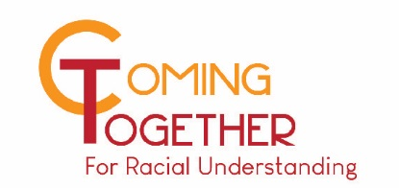
Current Priorities and Plan of Work (cont’d)
Developing Pathways to Resilient Communities
Broadband Access and Adoption
  Facilitate the work of the National Digital Education Extension Team (NDEET) alongside the Extension Committee on Organization and Policy (ECOP) Program Action Team
  Collaborate with 1890 system to build capacity to aid underserved communities in digital access with recently funded AFRI grant
Coming Together for Racial Understanding
  Support the 31 states that have trained Coming Together state teams
  Build capacity for dialogues through additional training
  Evaluate impacts and lessons learned
  Support the ECOP DEI Program Action Team
  Engage with NIFA on co-learning
  Strengthen DEI Efforts in the South LGU System

Slide 7




Current Priorities and Plan of Work (cont’d)
Building Strategic Partnerships
CREATE BRIDGES
  Continue efforts with the six pilot states to explore ways to strengthen the retail economic sector in rural places
USDA Office of Partnership and Public Engagement
  Survey concerning the needs of socially disadvantaged farmers and ranchers and the organizations serving them
  Workshops to build capacity around proposal development and management
Extension Disaster Education Network (EDEN)
  Generate a set of materials to highlight this effort
Southern Region Program Leadership Network (PLN)
  Support the work of PLN along with helping support the Program Leadership Committee’s efforts to plan for the annual joint meeting
Southern Region Community Resource Development (CRD) Indicators
  Facilitate gathering and reporting of southern region CRD indicators

Slide 8

Current Priorities and Plan of Work (cont’d)
Mobilizing Resources around Emerging Issues and Opportunities
Interdisciplinary Network on Rural Population Health and Aging
  Mentorship to pilot grantees and early career scholars
  Journal of Rural Social Sciences special issue
  Proposal writing workshop for research collaboration
  Work with the W4001 multi-state group to organize a policy symposium
Examine Intersections of Existing Programs & Listening Sessions Data
  Address key topics relevant to the South, including specifically: housing, disaster, COVID-19 impacts, workforce development, and grant writing/management skills
This Photo by Unknown Author is licensed under CC BY-SA-NC

Slide 9
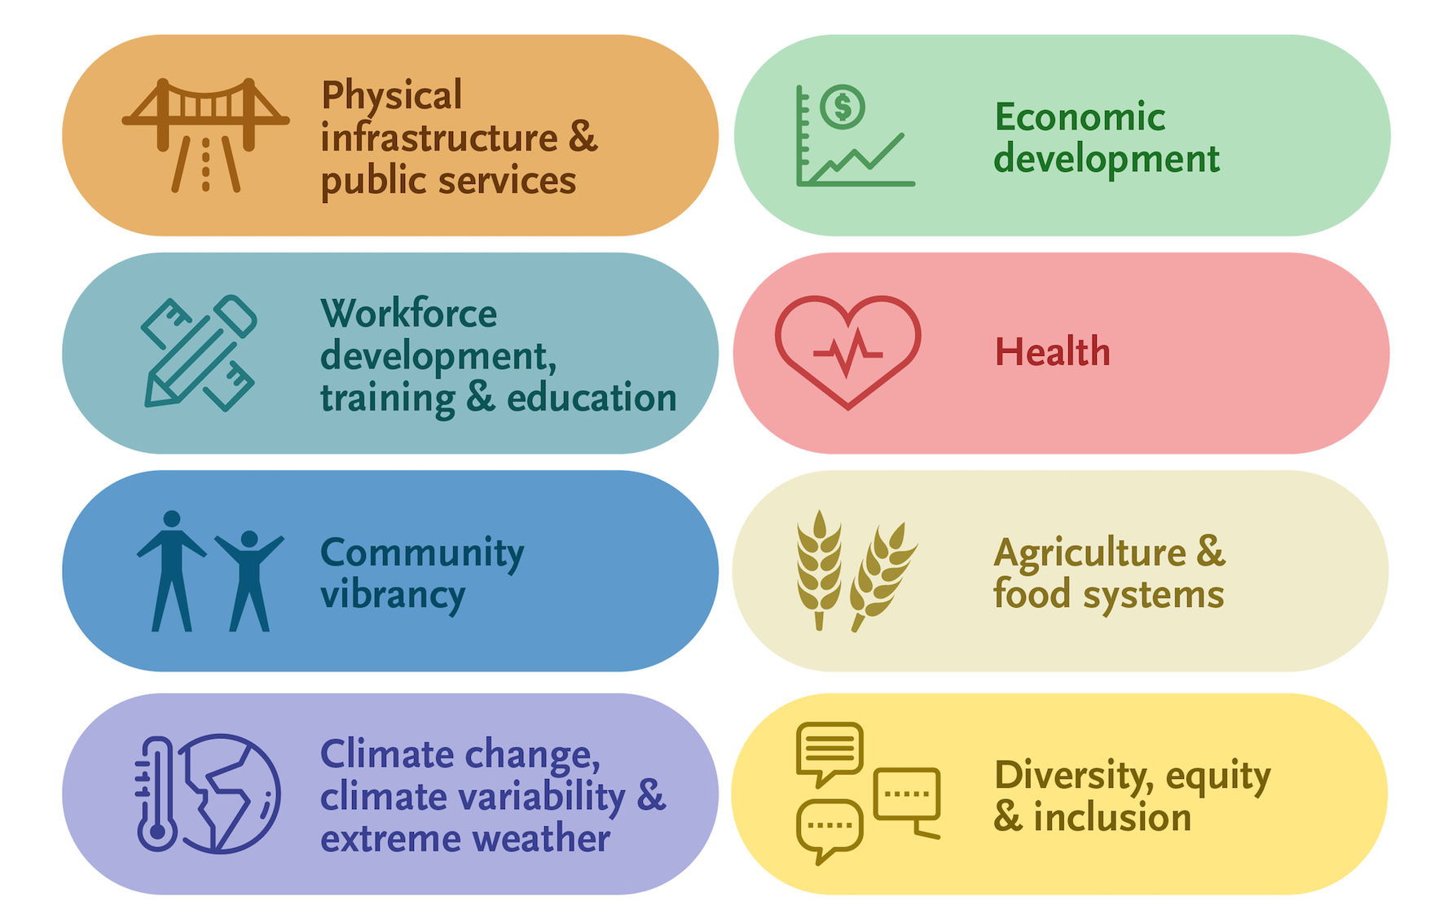
Items for Further Consideration
Community Priority Setting
What can we learn from the Community Priority Setting Listening Survey and Virtual Sessions?
  Summary of findings
    Priorities, capacities, and preferred forms of assistance
    Assets, challenges, and opportunities
How can this be used to inform our work through the Southern Land-Grant University System?
Graphic developed by the Extension Foundation

Slide 10
Items for Further Consideration
Next Steps with Heirs’ Property Work
Formalize network
Advance working groups
  Research
  Outreach, Extension, and Technical Assistance
  Policy and Law
Develop a strategic plan
Apply to form a Southern Extension/Research Activity (SERA)

