Slide 1
NIFA Update
Southern Association of Agricultural Experiment Station Directors
Kevin Kephart
Deputy Director, Institute of Bioenergy, Climate, and Environment
Kevin.Kephart@USDA.gov
September 28, 2021

Slide 3

NIFA Hiring:
  National Program Leaders (Biological Sciences)
    Animal Health (DVM)
    Animal Nutrition/Growth/Heat Stress
    Plant Pathology
    Horticulture
    Food Science/Microbiology
  National Program Leaders (Social Sciences)
    Rural Sociology
  Program Specialists
This Photo by Unknown Author is licensed under CC BY-SA-NC

Slide 4
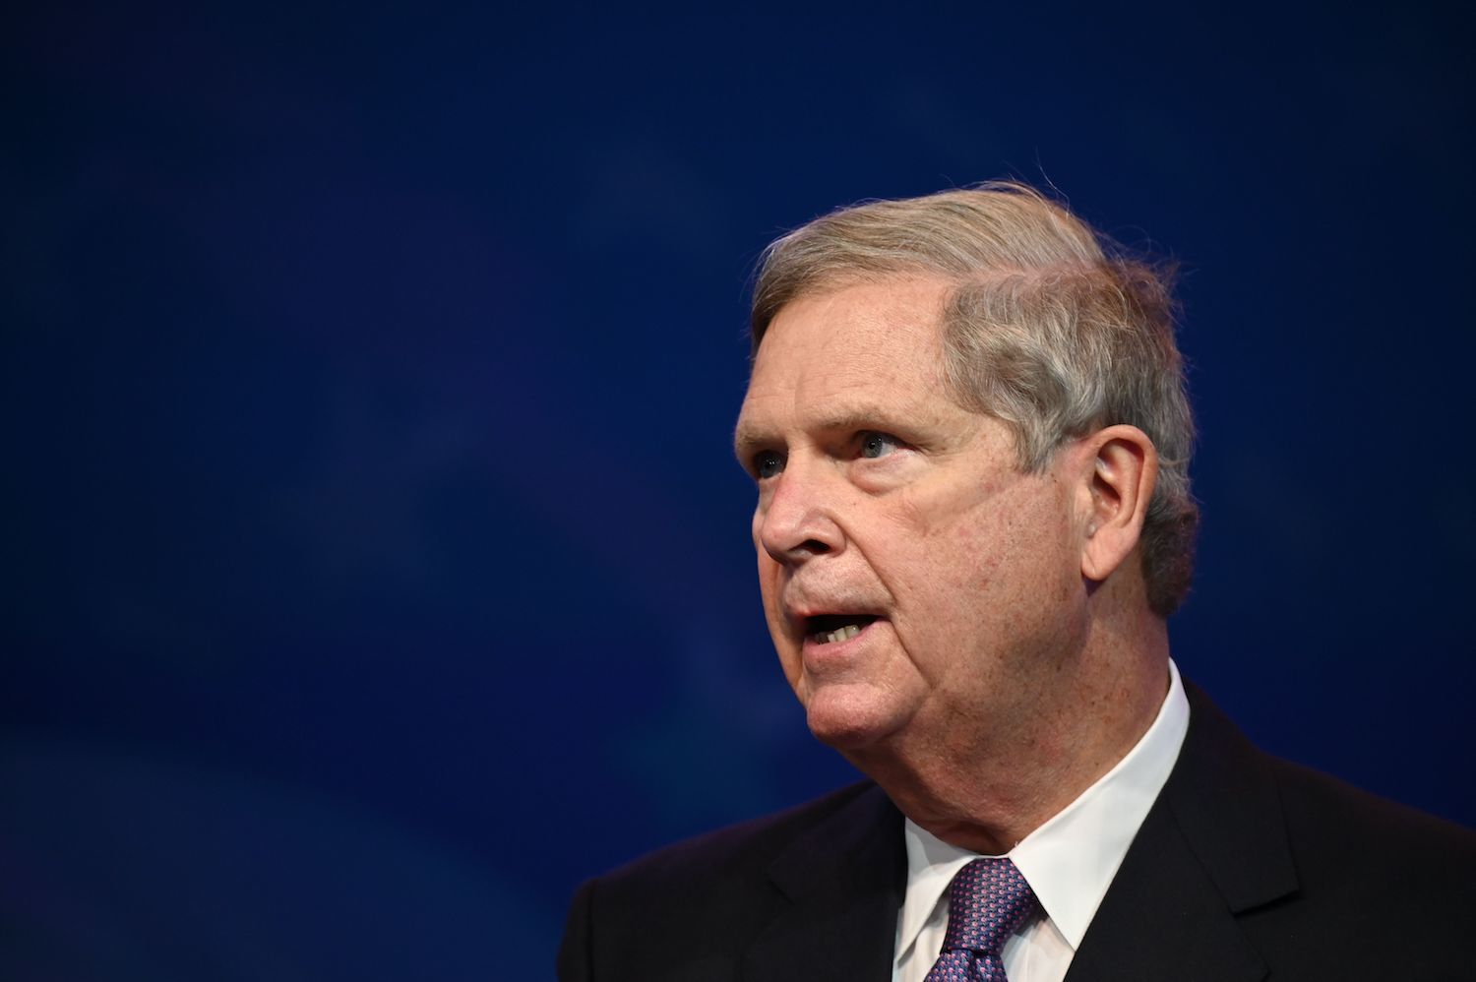
USDA FY2021 Priorities:
Containing the COVID-19 pandemic
Ensuring racial justice and equity
Ensuring food and nutrition security
Rebuilding the rural economy
Addressing the impacts of climate change

Slide 5

NIFA Core Teams
Climate Change – Megan O’Rourke
Nutrition Security – Sheila Fleischhacker
Economic Recovery – Kevin Kephart
Diversity, Equity, Inclusion – ‘Suresh’ Sureshwaran

Slide 6

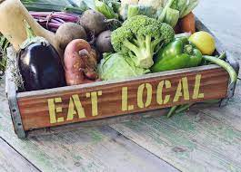
Economic Recovery Core Team
Goal: Identify how we could use NIFA resources and networks to promote rapid, sustained, and equitable economic recovery
  Ganesh Bora, Ag Systems​
  Amber Campbell, Environment​al Systems
  Daniel Cassidy, Environmental Systems​
  Melinda Coffman, IBCE​
  Brent Elrod, Family and Consumer Sciences​
  Vicki Finkenstadt, Ag Systems​
  Kevin Kephart, Ag Systems​
  Peter Motavalli, Community and Education
  ​Carlos Ortiz, Community and Education​
  Robbin Shoemaker, Ag Systems
  David Songstad, SBIR NPL, Ag Systems
Sponsors: Parag Chitnis, Tim Conner,
Sivapathasun Sureshwaran
Notes:
Kephart:

Slide 7
Core Team Charge
Advance rural economic and workforce development
USDA-wide economic recovery coordination meetings
Develop ideas and strategies related to:
  Post-pandemic economic recovery
  Circular economies in agriculture, food systems, renewable energy systems, rural communities
  workforce development
Implement new programs related to economic recovery/development
Ensure diversity, equity, and inclusion in these programs

Slide 8
Underway for FY2021
Develop plan for regional listening sessions on economic recovery/workforce development needs with Regional Rural Development Centers
Provide RFA revision suggestions
Develop ideas for new programs
Coordinate with other relevant federal funding agencies

Slide 9
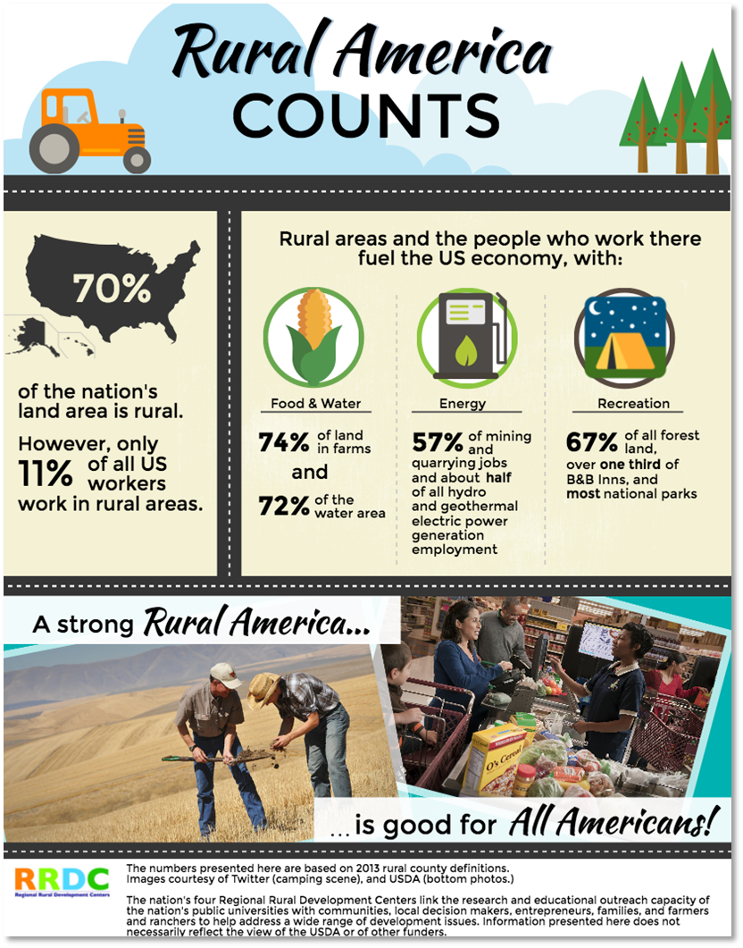
Stakeholder Survey
  Summer 2021
4 Regional Listening Sessions
  Autumn 2021
Report to NIFA
  November 2021

Slide 10
Farm of the Future:
The Committee directs the Under Secretary to collaborate with NIFA, ARS, and the Office of the Chief Economist to issue a competitive grant to an institution in the land-grant university system to establish a Farm of the Future testbed and demonstration site.
https://nifa.usda.gov/funding-opportunity/farm-future
Applications due October 15, 2021
Integrated projects required
Available funding $3,936,000

Slide 11
New NIFA REPORTING SYSTEM
NIFA Reporting System will replace the REEport portal
Response to LGU’s request to integrate Extension with research, streamline & reduce burden on partner institutions.
Because the technology behind REEport limits its functionality, NIFA decided to build an entirely new system that takes advantage of new technology.
NIFA goal to have all capacity and competitive programs in NRS by the end of CY 2022
  The order and release dates can change in response to user needs. This is common in an Agile process.

Slide 12
General Timeline
2020-2021: AREERA
Extension Program Initiation module was launched in September 2020
The first iteration of the Research Project Initiation module released in May 2021
Reporting modules currently being
New procedures to hasten Hatch initiations
2021: Institutional Profile, McIntire-Stennis, RREA, Animal Health, and Smith-Lever Special Needs
2022: Competitive Programs

Slide 13
Other Items
Secretary Vilsack
Speech on Climate Change
Colorado State University
Wednesday, September 29
YouTube

Slide 14
Thank You
Kevin Kephart
Kevin.Kephart@USDA.gov

