Slide 1
Southern Rural Development Center 2020-2021 Update
Steve Turner, SRDC Director
SAAESD Meeting April 22, 2021

Slide 2
Overview
Current Events & SRDC Response
COVID 19
Racial Justice
Economy
Future
Administration Priorities
SRDC

Slide 3
COVID 19: SRDC Responses
Broadband
Access
Resiliency
Resources
Online
Skill-Building
Networking
Support
Notes:
Broadband access:
Hosted a webinar with NDEET to describe various broadband access options and opportunities (April)
Supported 4H Tech Changemaker efforts to advance digital skills
Resiliency Resources:
Hosted six online state summits with OPPE to communicate relevant resource opportunities
Partnered with the SERA 47 Local Foods System team to develop a Food Systems Repository related to COVID-19: https://sera-47.extension.org/covid-19-resources/
Online Skill Building:
Hosted a workshop on working with virtual teams based on curriculum generated through a PLN collaboration: http://srdc.msstate.edu/virtualteams/index.html
Created or transformed five sets of curricula resources into online training workshops
Network Support:
Aided NACDEP in hosting their 2020 annual conference online
Supported the SRPLN annual meeting online

Slide 4
Racial Justice: SRDC Response
Coming Together for Racial Understanding
Heirs’ Property

Slide 5
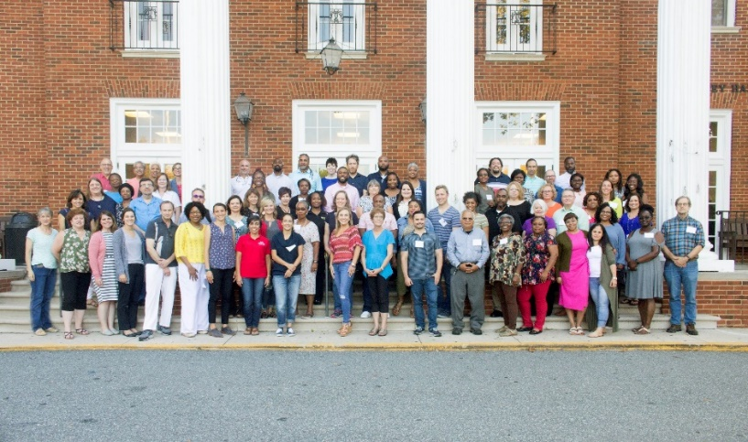
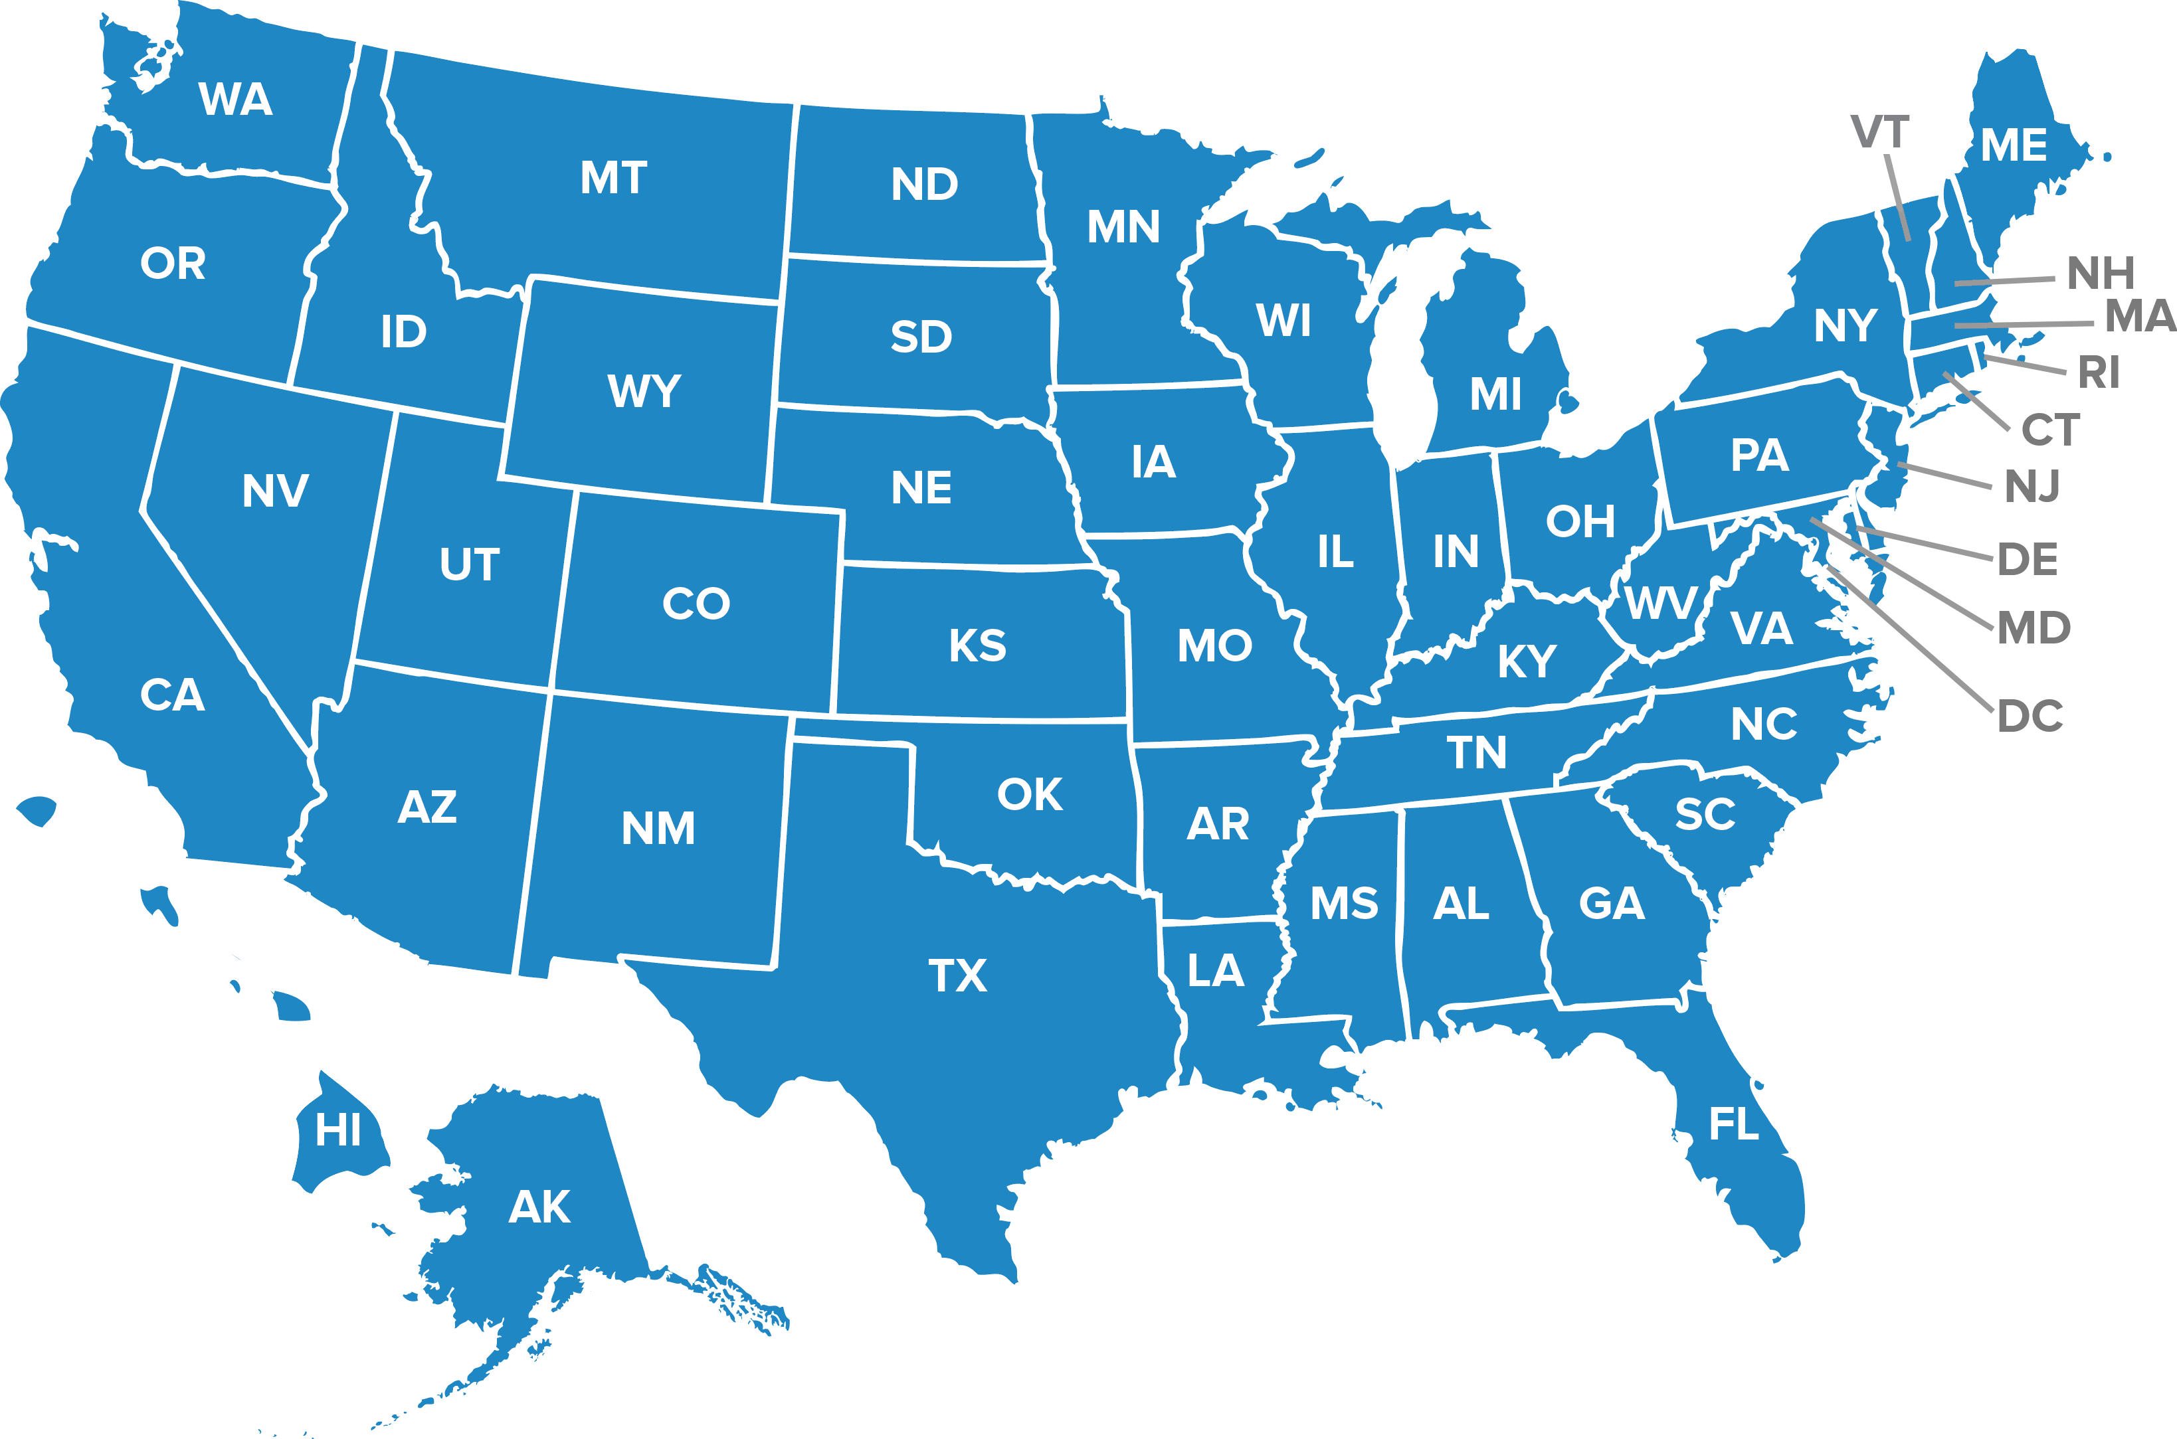
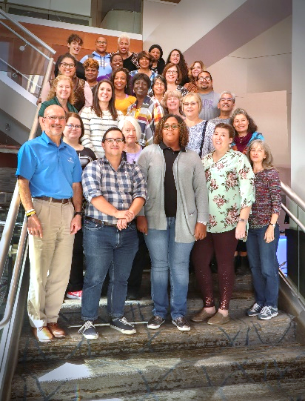
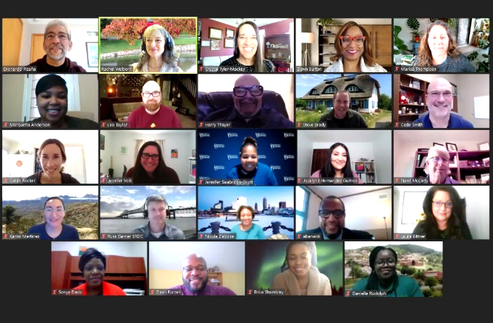
Coming Together for Racial Understanding
Participating States
2018
2019
2021
Notes:
This slide shows participating teams by state and the year they were trained.

Slide 6
Current and Future Efforts:
2020 Efforts:
Leadership Sessions with ECOP, ESS, AEA, and ASRED – Fall 2020
Expand CTRU National Training Team
Southern Region CRD Dialogue Series (Nov. 2020 – Feb. 2021)
Journal of Extension article published October 2020*
Piloted Ripple Mapping
Spring 2021:
CTRU virtual train-the-trainer pilot Jan.-Feb.
Ongoing support to research team
Southern Region Extension Administrators and Directors Series
Workshop for CTRU teams to explore learnings through the lens of institutional structures – What has hindered or helped efforts to build dialogues and promote diversity, equity and inclusion internally?
Synthesis report
*https://www.joe.org/joe/2020october/comm1.php
Notes:
https://www.joe.org/joe/2020october/comm1.php

Slide 7
Heirs’ Property: Progress to Date
Listserv established with 198 LGU, non-LGU, and non-profit professionals identified
Resource page established: http://srdc.msstate.edu/heir_property/index.html
USDA/AFRI SEED grant received to:
Conduct baseline research on the prevalence of heirs’ property in the South
Convene Research/Extension/Outreach stakeholders to develop a regional strategic plan for building capacity to address heirs’ property issues, February 24-25, 2020
Co-sponsor:
Notes:
Deleted: “Develop template for information and education” - not sure what you meant by this. This might have been a comment, but I don’t think we’re ready to say this would happen until we complete the survey to find out what is needed.
Moved to speaker notes as the slide was too full:
Questions
Extent of issue?
Economic, social, and personal impacts?
State and Federal legislation impact/

Slide 8
Heirs’ Property Research
USDA AFRI Purpose: Estimate the extent of heirs’ property in the South
Conclusions
Southeastern counties with minority majority population have significant amount of heirs’ property
Challenges –1) Variation in terms, 2)Different county data management systems
Data Analysis requires time and resources
Robert Zabawa
Tuskegee University
Jimmy Henry
Prairie View A&M University
Sandra Thompson
Florida A&M University
Notes:
Deleted: “Develop template for information and education” - not sure what you meant by this. This might have been a comment, but I don’t think we’re ready to say this would happen until we complete the survey to find out what is needed.
Moved to speaker notes as the slide was too full:
Questions
Extent of issue?
Economic, social, and personal impacts?
State and Federal legislation impact/

Slide 9
The Racial Wealth Gap, Persistent Poverty, and Heirs’ Property: Analysis, Connections, Solutions.
USDA/AFRI Three Year Project/Objectives:
Identify the relationship between heirs’ property, persistent poverty, and the racial wealth gap.
Investigate outcomes associated with resolving heirs’ property ownership.
Develop and implement a targeted education and outreach program to address heirs’ property resolution.
Partners:
SRDC
U.S. Forest Service
Tuskegee University
Mississippi State University
Center for Heirs’ Property Preservation
Notes:
Deleted: “Develop template for information and education” - not sure what you meant by this. This might have been a comment, but I don’t think we’re ready to say this would happen until we complete the survey to find out what is needed.
Moved to speaker notes as the slide was too full:
Questions
Extent of issue?
Economic, social, and personal impacts?
State and Federal legislation impact/

Slide 10
Economy: SRDC Responses
Walmart – CREATE BRIDGES: Retail and Tourism in Rural America
USDA Office of Partnership and Public Engagement
Southern Region Program Leadership Network (PLN)
Notes:
Walmart – CREATE BRIDGES: Retail and Tourism in Rural America
Added 3 States – North Carolina, Illinois, New Mexico
Implemented strategies to combat COVID challenges – AR, KY, OK
USDA Office of Partnership and Public Engagement
Piloted five online Train-the-Trainer Workshops on Veterans, Housing, Youth Workforce Development, Socially Disadvantaged Farmers and Ranchers, Grant Writing
Hosted state focused summits on COVID-19 resources in partnership with LGUs (AR, OK, TX, VA, NM, LA [fall 2020])
Southern Region Program Leadership Network (PLN)
Facilitate of the Program Leadership Committee work
Maintain PLN website and listservs
Coordinate Southern Region Community Resource Development Indicators

Slide 11
CREATE BRIDGES
Partnership Leads
Business Retention & Expansion surveys
Arkansas 117
Kentucky 47
Oklahoma 80
Employee Perspectives surveys
Arkansas 100
Oklahoma 450
Kentucky 96
Strategic planning and
implementation in 2021
Phase II States: NM, IL, NC
Notes:
CREATE BRIDGES: Celebrating REtail, Accommodations, Tourism and Entertainment by Building Rural Innovations and Developing Growth Economies
Project funded by Walmart
Purpose: Strengthen retail, accommodations, tourism, and entertainment industries in rural regions by raising awareness of the impact these businesses have on the local economy, determining challenges and assets impacting those businesses, and developing and implementing strategies to strengthen those sectors.
Business Retention & Expansion numbers are surveys completed thus far. Surveys are ongoing in Kentucky and Oklahoma may continue in one region.
Current regions are in Year 3 of a three-year grant.
In 2020 CREATE BRIDGES will expand to 3 additional states, with one region in each state. Work will continue in original states.

Slide 12
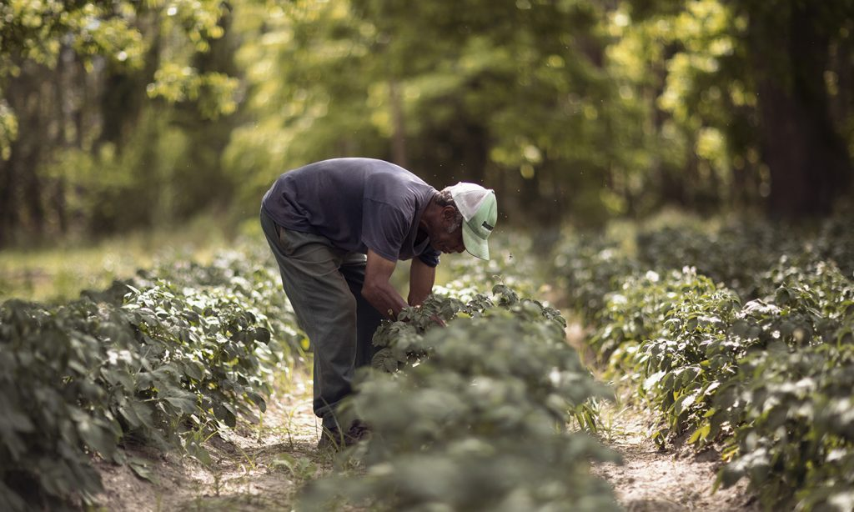
Partnering with USDA OPPE, continued:
2020 Fall - Three train-the-trainer resource kits developed:
Farm Financial Literacy:
Joy Moten-Thomas (FVSU)
Anthony Reed (Alcorn)
Anthony McCarty (Alcorn)
Caroline Banks (Alcorn)
Iris Crosby (UAPB)
Strategies for Farm Bill Opportunities:
Sam Cook (NC State)
Gregory Goins (NCAT)
Arnab Bhowmik (NCAT)
Godfrey Gayle (NCAT)
Harmandeep Sharma (NCAT)
Osei Yeboah (NCAT)
Heirs’ Property:
Robert Zabawa (Tuskegee)
Kara Woods (Tuskegee)
Conner Bailey (Auburn)
Savi Horne (Land Loss Prevention Project)
Lorette Picciano (Rural Coalition

Slide 13
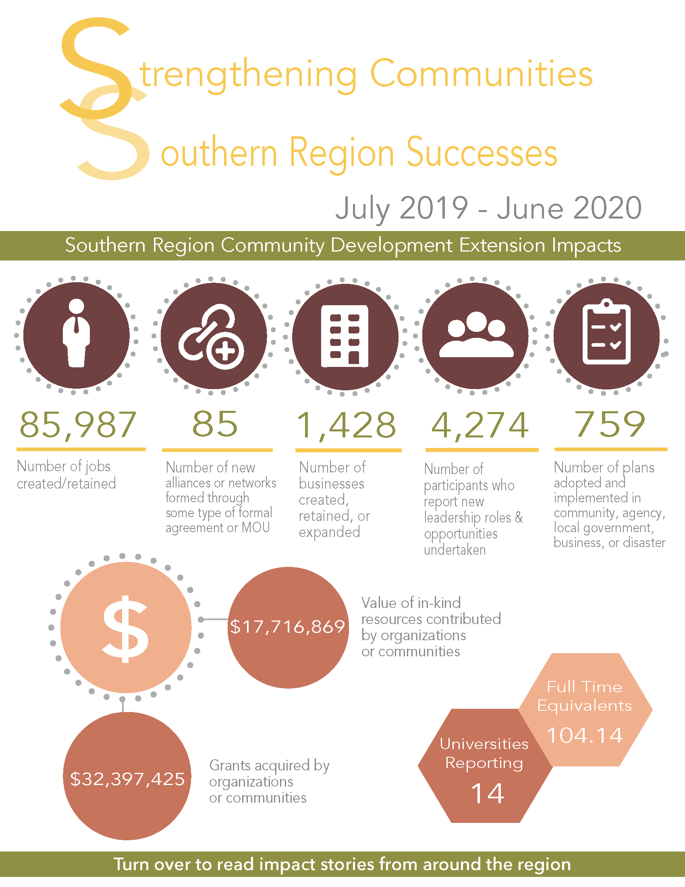
Southern Region Community Development Extension Impacts 2019-20
13 Universities Reporting (29 total)
$31 million - Dollar value of grants generated by organizations or communities
1,264 - Number of businesses created, retained, or expanded
85,891 - Number of jobs created/retained
98.14 - Estimated Effort (FTE)
Notes:
Deleted: “Develop template for information and education” - not sure what you meant by this. This might have been a comment, but I don’t think we’re ready to say this would happen until we complete the survey to find out what is needed.
Moved to speaker notes as the slide was too full:
Questions
Extent of issue?
Economic, social, and personal impacts?
State and Federal legislation impact/

Slide 14
Future – Federal Administration Priorities
Responding to COVID-19
Addressing Climate Change
Advancing Racial Equity
Promoting Economic Vitality
This Photo by Unknown Author is licensed under CC BY-SA-NC

Slide 15
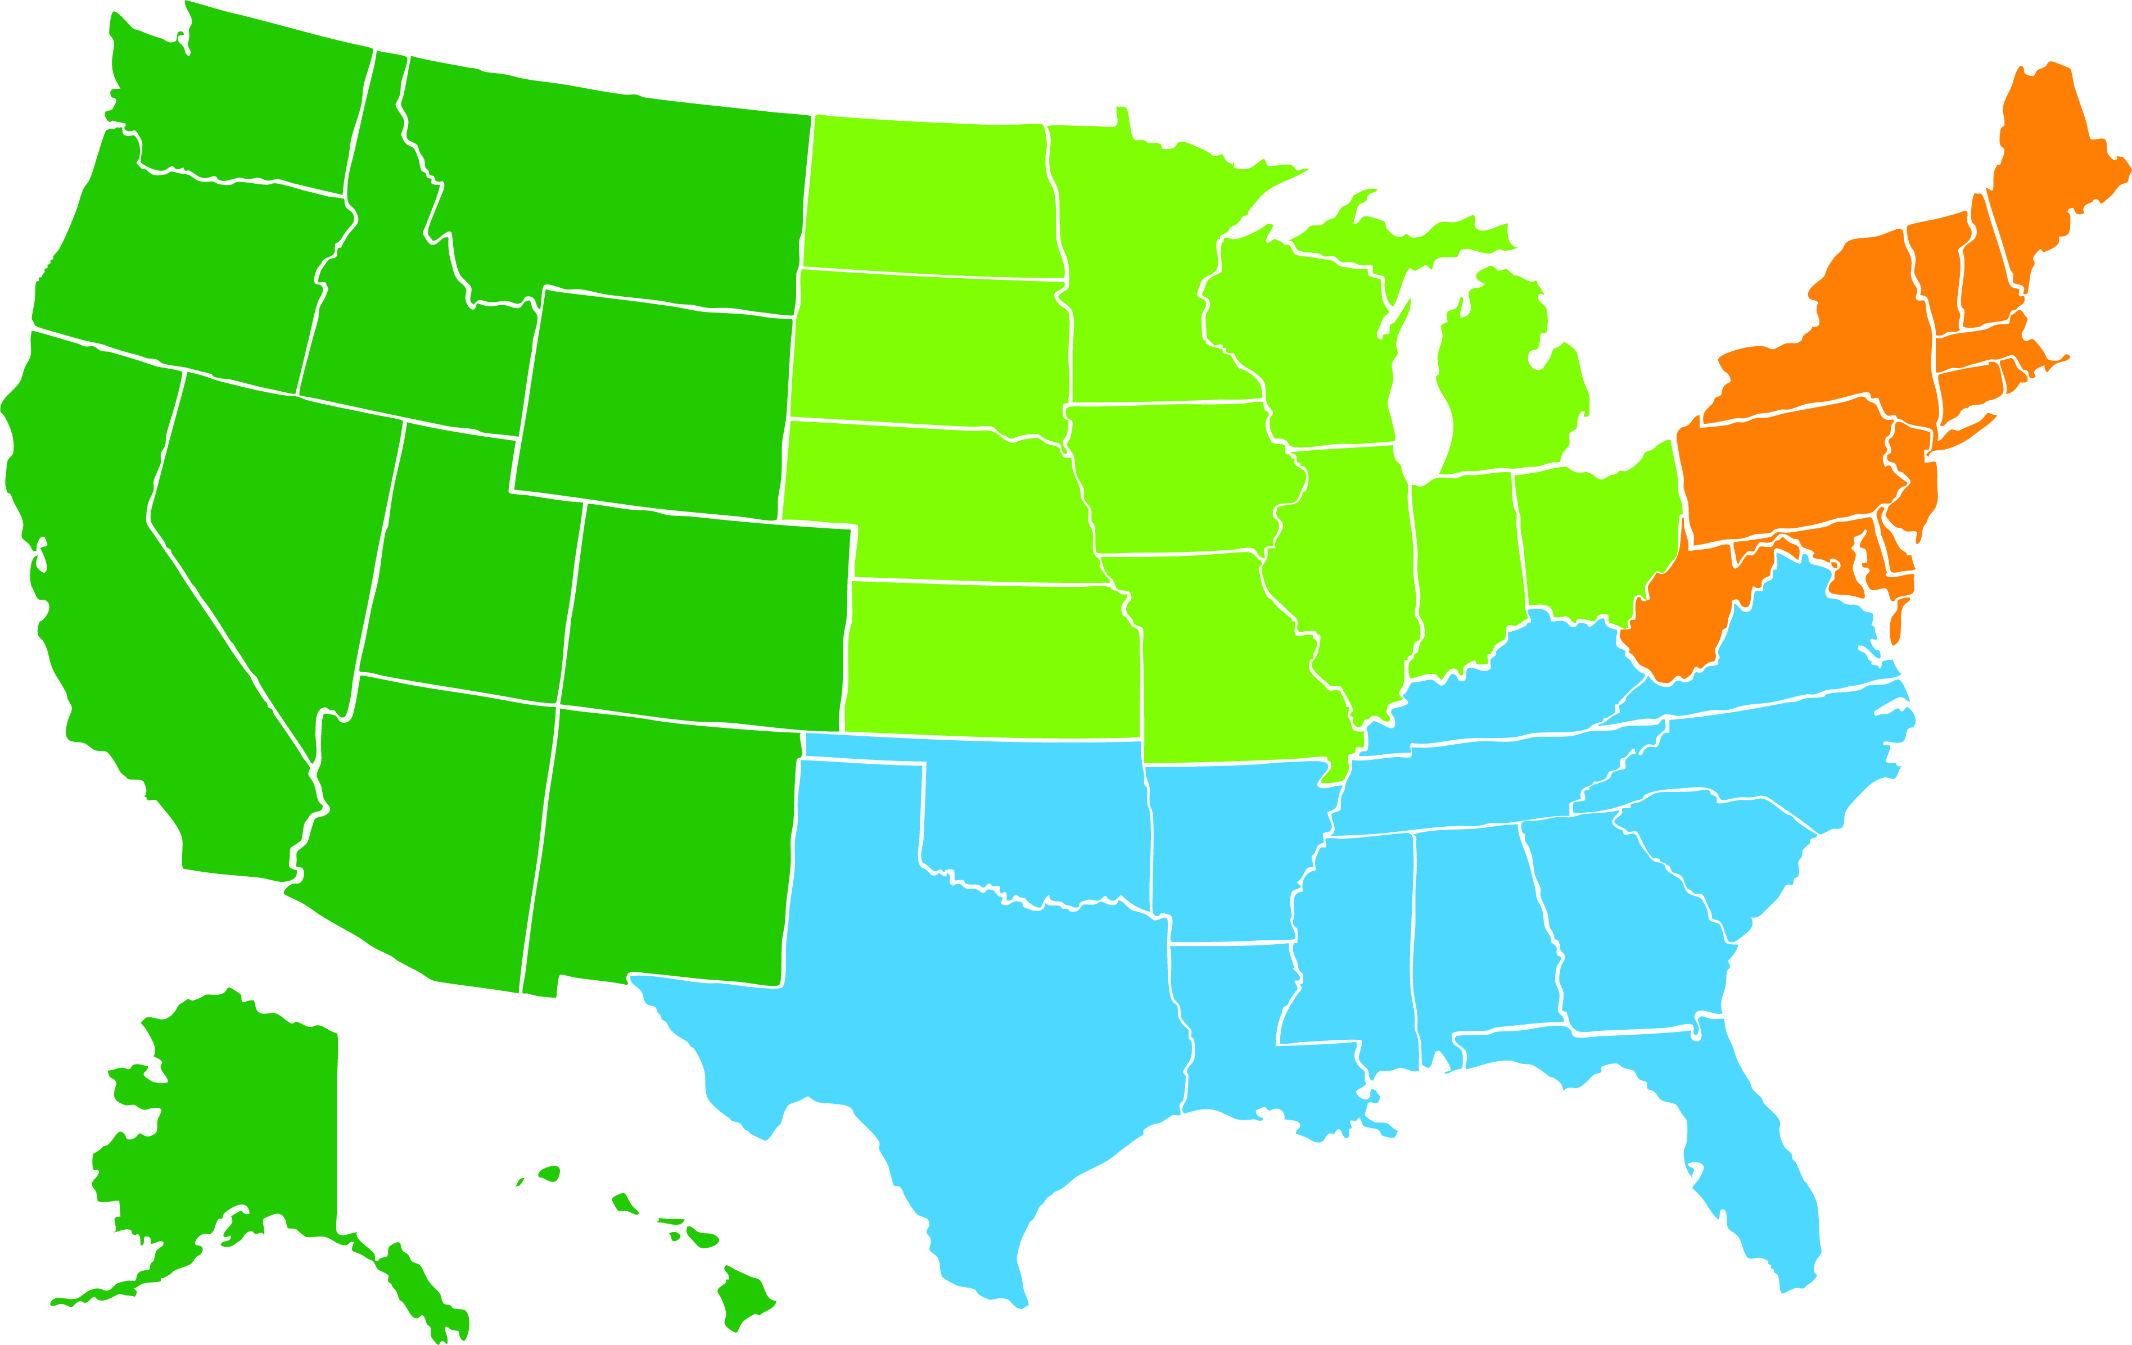
Future - Regional Rural Development Centers and SRDC News
North Central Region Center for Rural Development
Moved to Purdue University – September 1, 2020
SRDC
New Director August 2, 2021 – Dr. John Green
Communications Coordinator – Carmen Kelly

Slide 16
Questions, Thoughts, Discussion

