Slide 1
Undergraduate Research Opportunities
Presented at the AP-AES Joint Meeting
September 18-19, 2012
Atlanta, GA
Bob Godfrey
Director & Professor – Animal Science

Slide 2
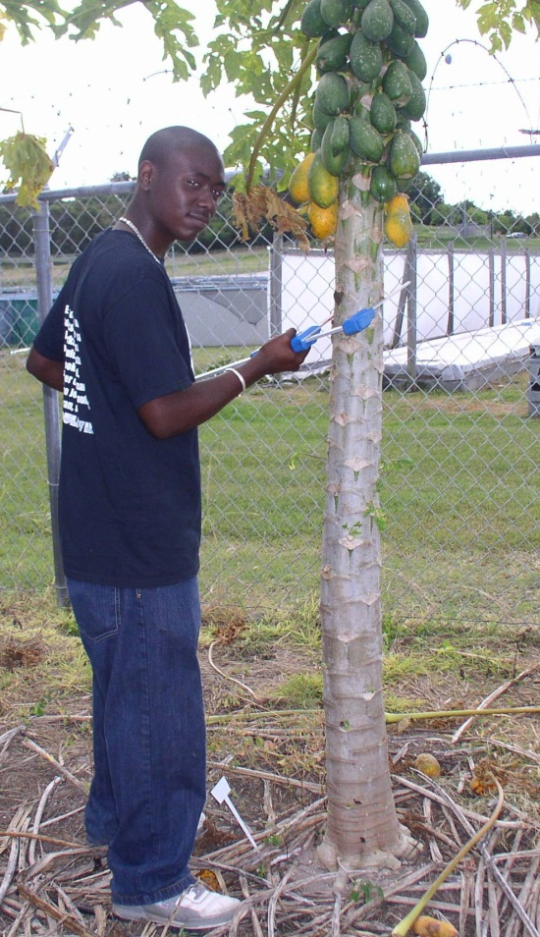
Situation at UVI
UVI has no teaching program in agriculture; only AES and CES
Funds obtained through grants have been used to provide opportunities to support student research activities in AES labs
Students are mentored by faculty/professional staff in Agronomy, Animal Science, Biotechnology & Agroforestry and Horticulture & Aquaculture
Students are taught how to conduct research by being involved in all aspects of a project from experimental design to data analysis and presentation
Students enroll in BIO 495– Directed Independent Study and receive course credit for their time conducting research

Slide 3
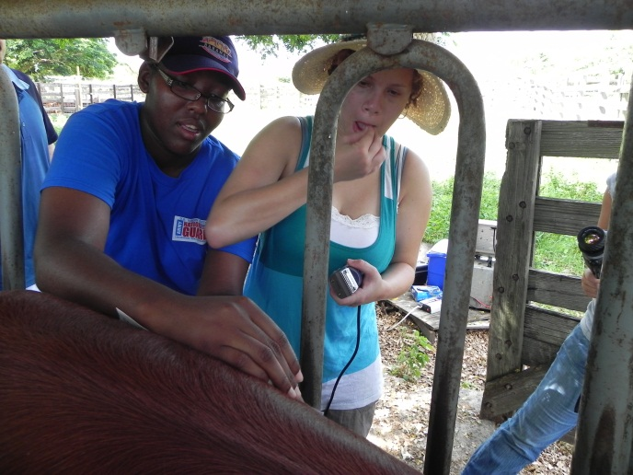
Funding Sources
NSF Minority Biomedical Research Support - Research Initiative for Scientific Enhancement (MBRS-RISE; 2003 - present)
NSF Minority Access to Research Careers (MARC; 2003 - present)
USDA-NIFA Resident Instruction Grants Program for Institutions of Higher Education in Insular Areas (RIIA; 2006 - present)
NSF - VI EPSCoR Program (2003 – present)
Other research grants when available (S-SARE, WRRI)

Slide 4
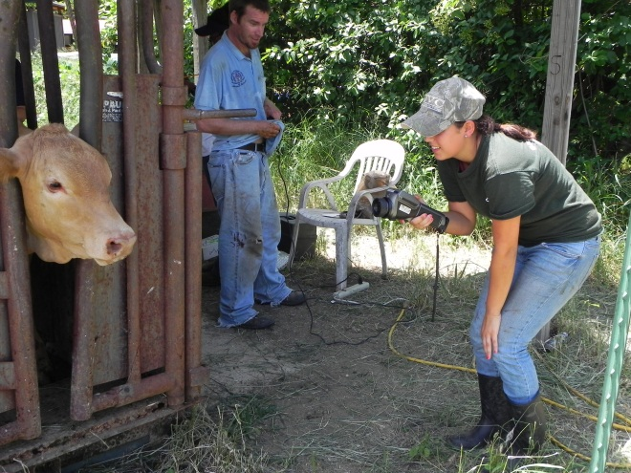
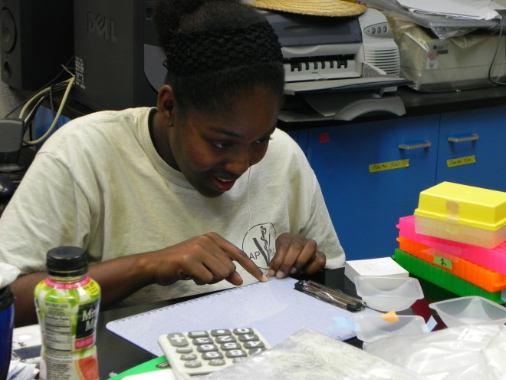
Limitations
Small size – UVI and AES
No agriculture curriculum to recruit students from
Low level of student interest in agriculture
Misconceptions about agriculture
Not just “farming”
Limited funding support for students in AES
AES faculty are 100% research appointments (Hatch funds)
Part time teaching faculty support from other funds

Slide 5
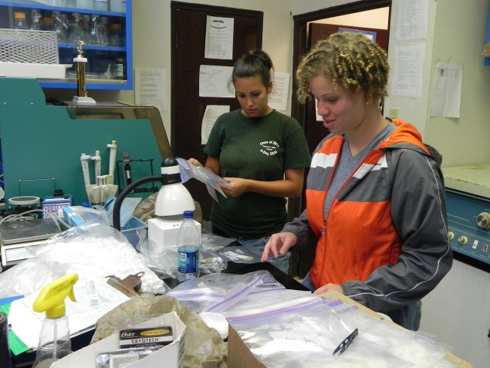
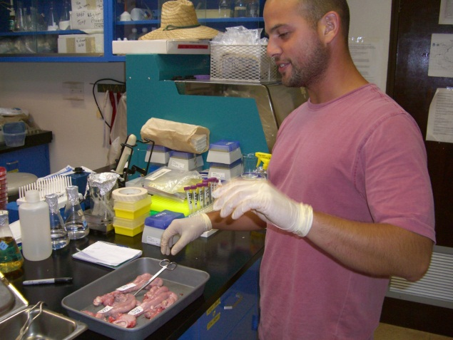
Outputs
Since 2006 RIIA funds have supported 24 undergraduate and 1 graduate student in AES
Prior to that we had 8 MARC and RISE students that worked in AES labs
Students have published their research and presented results at local, regional, national and international conferences
ASAS, AHS, CFCS, SAAS
UVI hosts two Student Research Symposia each year (STT and STX)
UVI developed the Emerging Caribbean Scientist program

Slide 6
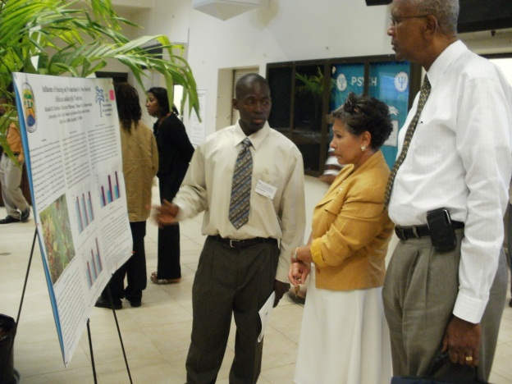
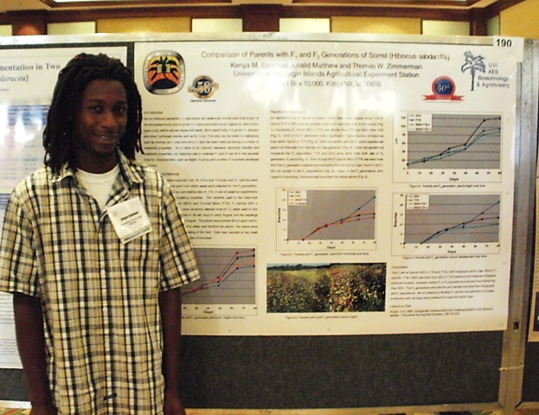
Outcomes
UVI undergraduate students have won awards for presentations at:
Annual Biomedical Research Conference for Minority Students (ABRCMS)
Southern Association of Agricultural Scientists (SAAS) – Horticulture section
American Society for Horticultural Science
Several students have gone on to grad school & vet school or have obtained jobs in academia or industry

