Slide 1
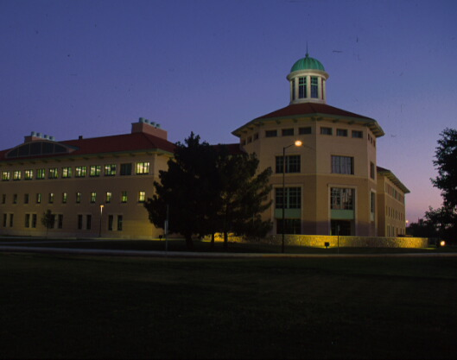
Developing True Multi-State Partnerships In Research
LeRoy A. Daugherty
New Mexico State University

Slide 2
Consortium for Cattle Feeding & Environmental Science

Slide 3
CONSORTIUM FOR CATTLE FEEDING AND ENVIRONMENTAL SCIENCES
Cooperating Institutions and Agencies
West Texas A&M University
Texas A&M University Agricultural Research & Extension Center
Texas Veterinary Medical Diagnostic Laboratory
USDA-Agricultural Research Service
Texas Tech University
New Mexico State University’s Clayton Livestock Research Center
Texas Cattle Feeders Association

Slide 4
CONSORTIUM FOR CATTLE FEEDING AND ENVIRONMENTAL SCIENCES
Mission
Enhance the food animal industry’s global competitiveness and its capability to produce a safe, wholesome, and inexpensive food supply
Achieved this in a environmentally sound manner through expanded cooperative research, education, and extension programs of the various universities, state agencies, and federal agencies serving the Southern Great Plains

Slide 5
CONSORTIUM FOR CATTLE FEEDING AND ENVIRONMENTAL SCIENCES
The Consortium Provides
Over 40 scientists and engineers from Institutions and Agencies focused on developing new technologies and educational programs to enhance cattle feeding efficiency, feedlot cattle health, and environmental protection and natural resource management

Slide 6
CONSORTIUM FOR CATTLE FEEDING AND ENVIRONMENTAL SCIENCES
Consortium Priorities
Animal Nutrition, Health, and Management
Environmental Quality
Beef Safety and Quality
Biosecurity and Incident Management
Energy Management

Slide 7
NEW MEXICO MEAN ANNUAL SURFACE WATER BUDGET
Precipitation
85.3 Million Acre Feet
Inflow
2.4 Million Acre Feet
Evaporation
82.0 Million Acre Feet
Usable
1.2 Million Acre Feet
Other Losses
1.1 Million Acre Feet
Outflow
3.4 Million Acre Feet

Slide 8


Efficient Irrigation for Water Conservation in the Rio Grande Basin
RIO GRANDE BASIN INITIATIVE
  TAMU Agri-Life Extension and Research (TWRI)
  NMSU Agricultural Experiment Station and Cooperative Extension
Craig Runyan
NMSU Coordinator
B.L. Harris
Project Director

Slide 9

Rio Grande Basin Initiative
Federal Congressional support thru USDA-National Institute for Food and Agriculture (NIFA)
Approximately $3 million per year (Approximately $25 Million Total)

Slide 10
Rio Grande Basin Initiative
Extension – county and regional
  County Extension Agents
  Specialists
Research
  Agricultural Research and Extension Centers
  Draw on expertise throughout the states

Slide 11
Rio Grande Basin Initiative
Collaborators:
  Irrigation Districts
  Agricultural Commodity Organizations
  City-County-Regional Development Groups
  State and Congressional Elected Officials in both Texas and New Mexico
  State and Federal Agencies
  Other Universities
  Selected Consultants

Slide 12

Tasks
Irrigation District Studies
Irrigation Education and Training
Institutional Incentives for Efficient Water Use
On-Farm Irrigation System Management
Urban Water Conservation
Environment, Ecology and Water Quality Protection
Saline and Wastewater Management and Reuse
Basinwide Hydrology, Salinity Modeling and Technology
Administration, Communications and Accountability

Slide 13
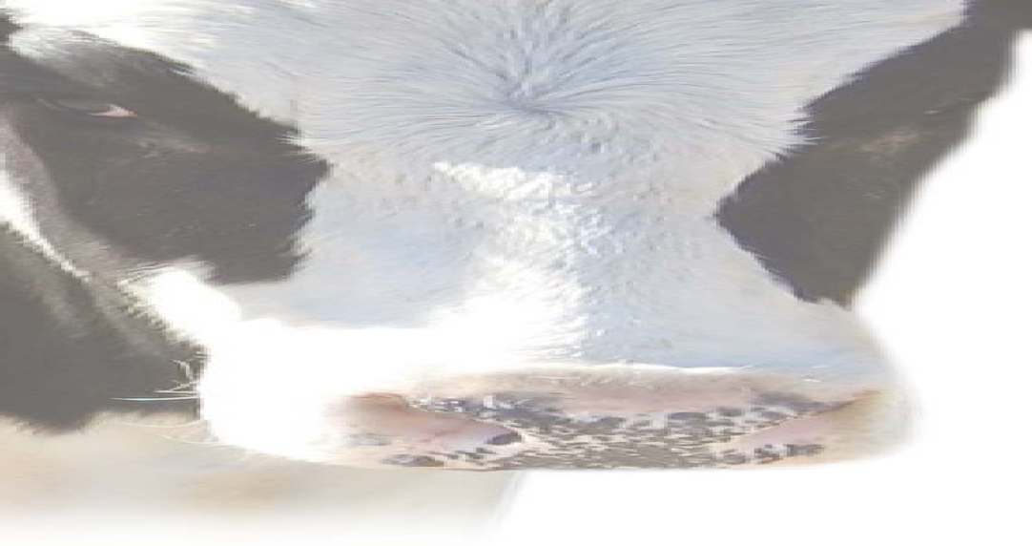
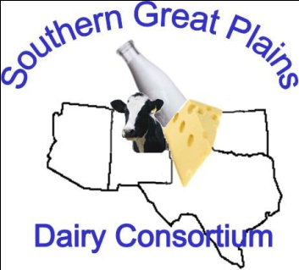
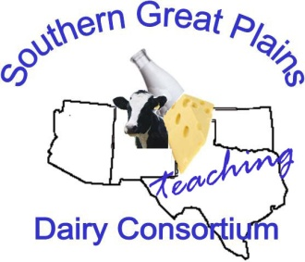
Southern Great Plains Dairy Consortium

Slide 14
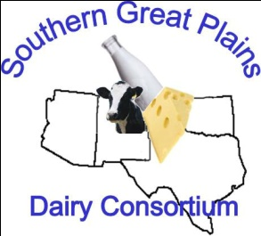
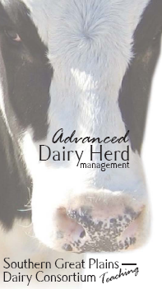
Challenge
The Dairy infrastructure has developed tremendously in last 10 yrs.
The Academic infrastructure to support this dairy industry has not!
Individually institutions don’t have the resources, faculty or facilities
Texas A&M, NMSU & UA all closed dairies

Slide 15
Background and justification –
New Mexico and Texas
#1 California: 3,514
#2 Wisconsin: 2,179
New Mexico and Texas 1,501
#3 New York: 1,099
#4 Idaho: 1,047
#5 Pennsylvania: 935
#6 Texas: 789
#7 Minnesota 784
#8 New Mexico: 712
#9 Michigan: 698
#10 Washington: 487
New Mexico and Texas combined: #3 nationally!
Source: NASS, May milk production release June 18, 2009

Slide 16
Background and justification –
New Mexico and Texas

Slide 17
Action
Southern Great Plains Dairy Consortium has been established (2007)
Consortium is the framework for coordinating Research & Extension and Teaching efforts
Research & Extension –
  producer identified issues
  leverage expertise across participating universities
  leverage research equipment and facilities across participating universities
Teaching –
  leverage knowledge and expertise to advance students in hands-on large herd management class

Slide 18
Participants
NMSU Extension & Experiment Station
Texas AgriLife Research & Extension Service
West Texas A&M University
Texas Tech University
Tarleton State University
University of Arizona
Oklahoma State University
USDA – Agricultural Research Service
Texas Veterinary Medical Diagnostic Lab

Slide 19
Supporters
Dairy Producers of New Mexico (DPNM)
Texas Association of Dairymen (TAD)
Dairy Farmers of America (DFA)
Select Dairy Producers
DairyMax
Southwest Dairy Museum
Support = legislative support!

Slide 20

Focus areas as defined by producers:
Environmental Quality
Dairy Production
Dairy Products & Milk Quality
Human Resource Development
Water Utilization
Energy Resources
Economics & Marketing
Resources for Industry

Slide 21
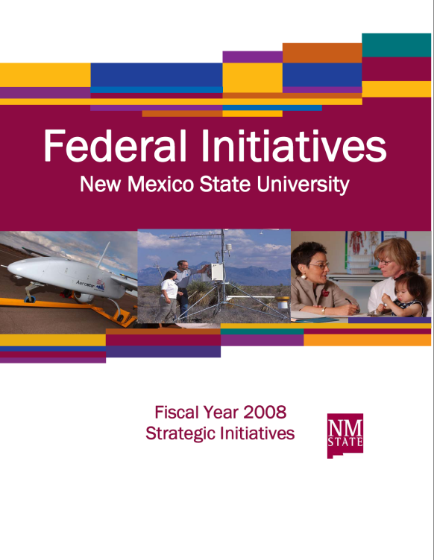
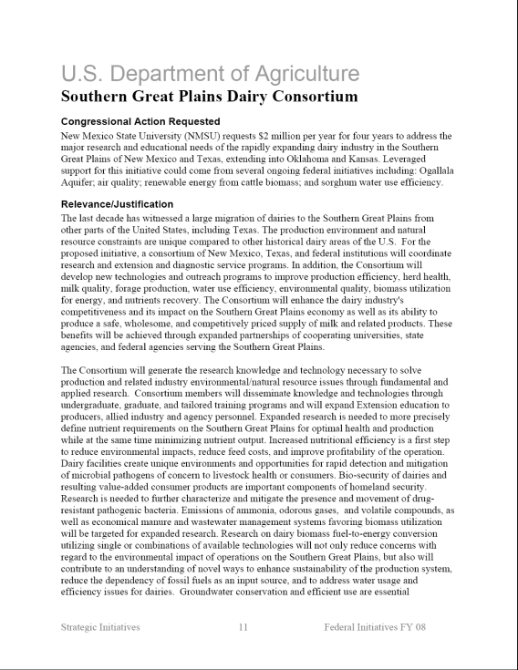
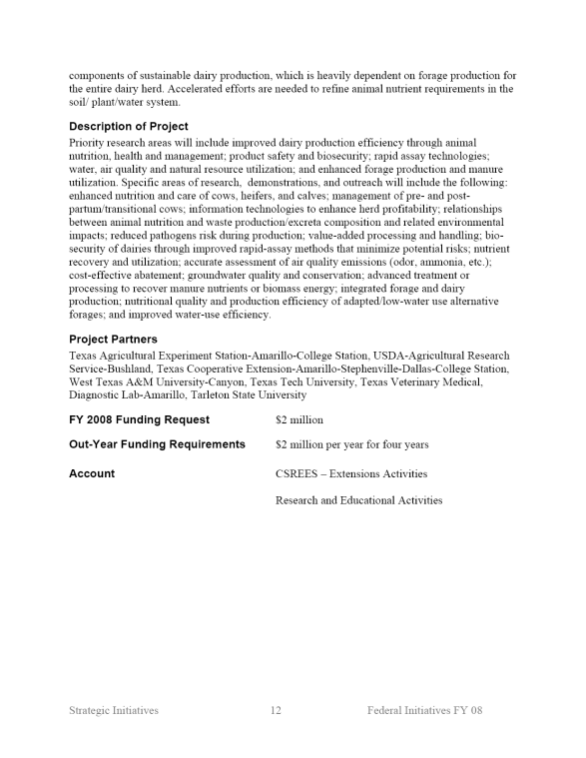
Research & Extension Funding: Federal Initiatives

Slide 22
Teaching Funding:
Private Initiatives
Allied Industry Sponsors
Dairy Promotion Groups
Producer Associations
Dairy Producers
Universities
Grant funding (Higher Education Grant)
Cost = $2500/student for 6 wk. program

Slide 23
Course Structure
Structure
  6 week session with 1 week modules
  6 week internship possible
Credits determined by home university

Slide 24

Cooperating Institutions

Slide 25
Students (2009: 50/50% inside/outside consortium schools)
2008 Class (18)
  TAMU (8)
  NMSU (3)
  Un. of AZ (3)
  WSU (2)
  Abilene Christian (1)
  Texas Tech (1)
2009 Class (22)
  TAMU (5)
  NMSU (3)
  Un. of AZ (3)
  WSU (2)
  K State (2)
  WTAMU (1)
  CSU (1)
  Tarleton (1)
  Un. of ID (1)
  Westmont (1)
  International (2)

Slide 26
