Slide 1
Regional Business Center
A Pilot of Clemson Extension and Clemson Experiment Station

Slide 2
Objective
Consolidate business functions of Edisto REC and four county Extension offices (Aiken, Bamberg, Blackville, Orangeburg) in a business model that:
Is sustainable long term
Supports cross-training
Reduces overall operating costs
Increases programmatic/staff FTE ratio
Serves clients via available technology

Slide 3
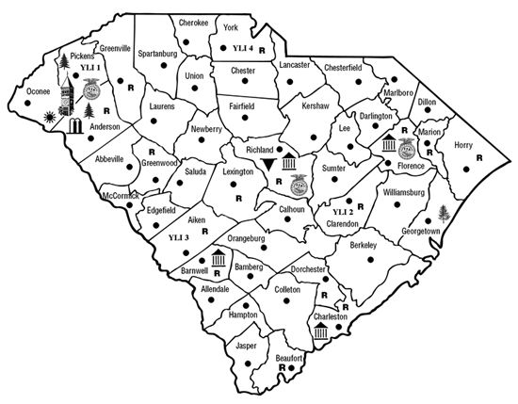
South Carolina Counties

Slide 4
Lessons Learned
Communication
Location
Maximum - 3 counties
Exclude high traffic county offices

